Slide 1
A Distinctive Framework for Adventist Nursing: How will it influence curriculum and practice?

Slide 3
Curriculum
The systematic, formal method of transmitting knowledge in an academic setting.
Is knowledge transmitted or is it individually built upon information?
Can information be delivered in a vacuum void of feelings and attitudes? (Charismatic power, passion)
Are the three domains of learning included in the curriculum? Cognitive – knowledge
Psychomotor – skills
Affective – feelings and attitudes
Notes:
Ask ourselves 3 questions

Slide 4
Transmitting the constructs of the framework through the curriculum
Caring
Connecting
Empowering
Can these be transmitted by delivering information ?

Slide 5
Traditional approach to curriculum development
Philosophy/mission statement
Conceptual model/Theoretical Framework
Plan of studies (courses)
Objectives leveled by course, year, and end of program
Content and learning experiences for each course
Provides a systematic, logical, mechanistic sequence of activities

Slide 6
Problems with traditional approach to curriculum development
Assumes
Learning is logical, sequential, orderly
Faculty can exert control over knowledge
Results in overloaded curriculum
Must know
Nice to know

Slide 7
Challenges to the traditional approach
It doesn’t address certain realities:
Learning is more chaotic in nature
Focus on learner and desired outcomes
Individuals take different paths to reach these outcomes
A generic well-scripted road map may not meet every student’s patterns of learning.

Slide 8
Current trend for curriculum design
Start at the end by identifying desired (outcomes/competencies/objectives) and work backwards
Framework shaped by concepts embedded in the outcomes and competencies
Faculty discuss what students must be able to demonstrate (core characteristics/qualities) rather than what content must be taught

Slide 9
Three domains of educational outcomes
Cognitive: intellectual outcomes
Psychomotor: skills
Affective: interests, attitudes, appreciation, methods of adjustment

Slide 10
Conveying the curriculum
Legitimate or official curriculum- formalized written documents containing
philosophy
mission
program outcomes
slo, competencies
individual courses
course outlines, syllabi
Content, learning activities, and evaluation
Notes:
How will the framework impact the way the curriculum is conveyed?

Slide 11
Conveying cont…
Latent or hidden curriculum - lessons, norms, values and beliefs acquired through the social environment
Operational curriculum – what each teacher is required to transmit in areas of knowledge, skills, and attitudes. What is really communicated to the students.

Slide 12
Conveying cont…
Assessed curriculum – what is tested and evaluated
Learned curriculum – what the student actually learned
Null curriculum – content and skills, intentionally or inadvertently left out
Illegitimate curriculum – dispositions not quantifiable into behavioral objectives such as caring and compassion

Slide 13
Paradigm shifts
From training to education
From memorization to understanding rationale and acquiring skills and wisdom for clinical decisions
From product thinking to values-based human caring
From maintenance adaptation to anticipatory innovative learning

Slide 14
Recommendations for the future of nursing (Carnegie Foundation)
Teach students to think like a nurse (connecting, caring, and empowering)
Integrate classroom and clinical teaching
Teach students multiple ways of thinking: scientific reasoning, clinical reasoning,
Internalize what it means to be a professional
Application to our framework
Internalize what it means to be a SAU Nurse

Slide 15
Curricular models
Block curriculum
Content organized by medical condition
Theory taught in class over designated time followed by clinical practice
Concept-based curriculum
Integrating core concepts such as pain, inflammation, elimination, human development, addiction. Concepts expressed in different settings with different populations
Competency-based curriculum
Observable and measurable goals that students must reach

Slide 16
Nursing faculty participation
Curriculum design
Curriculum evaluation

Slide 17
A Distinctive Framework for Adventist Nursing: How will it influence practice?

Slide 18
Christ-centered worldview
Compassionate care demonstrated by Jesus
No compassion fatigue
Illustrated by
Good Samaritan
Father of the Prodigal Son
Acronym for compassionate care giving
Compassionate
Notes:
A characteristic of God is His tender, compassionate loving care as demonstrated by Jesus himself when He was on this earth.

Slide 19
C onnecting O beying M odeling P ardoning A ppreciating S avoring S haring II nterceding O ffering compassionate individualized caring N urturing A dvocating T ransforming
E mpowering/ educating
Notes:
Prerequisites for compassionate care are action verbs. Connect, obey, model, pardon , appreciate, savor, share, intercede, offer, nurture, advocate, transform, educate.

Slide 20
COMPASSIONATE
Connecting with God, Self, and Others
With God and self
More than know about
Branch of the true vine
Fruit of the Spirit
Enoch experience
Connectedness makes all else possible
With those within your sphere
Colleagues
Patients
Students
Families and Communities
Notes:
Your influence will never be neutral.

Slide 21
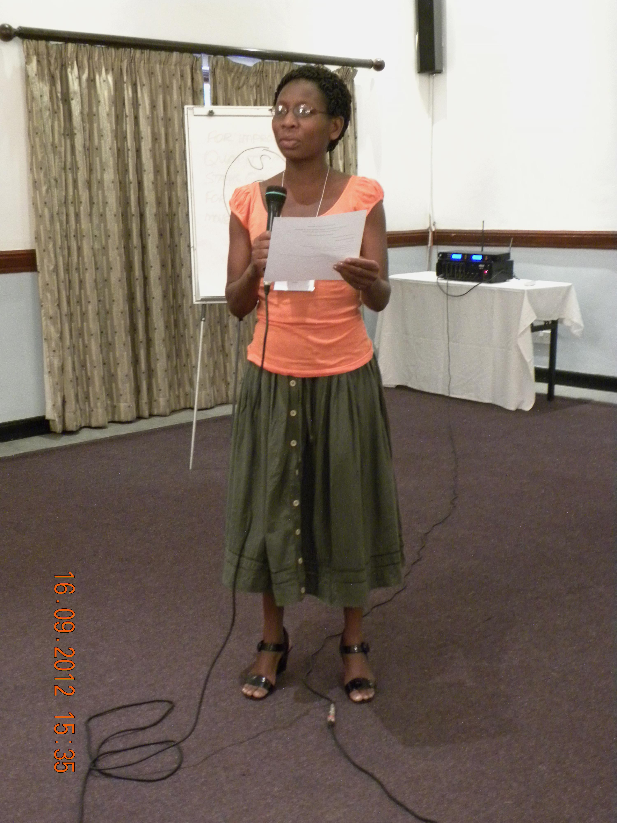
COMPASSIONATE
Obeying
Moral law
Laws of nature
Wall of protection
Divine calling
Your mission
Jonah experience
Notes:
Obedience

Slide 22
COMPASSIONATE
Modeling
Healthy lifestyle
Physical
Spiritual
Emotional
Notes:
Take time for restoration of your soul, for mental hygiene,

Slide 23
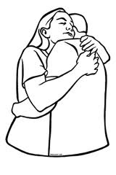
COMPASSIONATE
Pardoning
Forgive 70 x 7
Matthew 18:22 Jesus said to him, “I do not say to you, up to seven times, but up to seventy times seven.
Forgive 7 times in one day if necessary
Luke 17:4 And if he sins against you seven times in a day, and seven times in a day returns to you, saying, ‘I repent,’ you shall forgive him.”
Forgive those who are not compassionate towards you
Luke 23:34 Then Jesus said, “Father, forgive them, for they do not know what they do.”

Slide 24
COMPASSIONATE
Appreciating – being thankful and valuing
God’s forgiveness
What God has done in your life
The good in others
Value others as God does

Slide 25
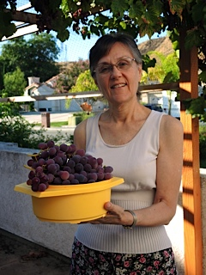
COMPASSIONATE
Savoring
God’s tender, compassionate, loving care
Psalm 34:8 Oh, taste and see that the Lord is good; Blessed is the man [woman] who trusts in Him!

Slide 26
COMPASSIONATE
Sharing
Don’t keep it selfishly for yourself
Share God’s love with others
Invite them to taste and see
Hebrews 13:16 But do not forget to do good and to share, for with such sacrifices God is well pleased.

Slide 27
COMPASSIONATE
Interceding
For your patients
For your colleagues
For your students
For those who do not have compassion for you
Matthew 5:44 But I say to you, love your enemies, bless those who curse you, do good to those who hate you, and pray for those who spitefully use you and persecute you,

Slide 28
COMPASSIONATE
Offering Individualized Care
“The greatest thing we have to offer our people [patients, students, colleagues], is not our education. It is not our good ideas. It isn’t even our gifts and abilities. It is the fruit of the time we have spent with the Savior, the utterly unique and unparalleled thing that happens when we are simply in His presence.” (Ben Patterson)
Prism

Slide 29
COMPASSIONATE
Nurturing
Going beyond caring to nurturing the soul by providing
Water
Sunshine
Fertile soil

Slide 30
COMPASSIONATE
Advocating
Protecting
Ensuring fair treatment
Intervening in behalf of the patient, the student

Slide 31
COMPASSIONATE
Transforming
Start with yourself
Romans 12:2 Do not be conformed to this world, but be transformed
Be a change agent within your sphere of influence
Ask God to increase your territory for His sake
1 Chronicles 4:10
Jabez cried out to the God of Israel, “Oh, that you would bless me and enlarge my territory! Let your hand be with me, and keep me from harm so that I will be free from pain.” And God granted his request.
Notes:
⁹ Now Jabez was more honorable than his brothers, and his mother called his name Jabez,^{[a]} saying, “Because I bore him in pain.” ¹⁰ And Jabez called on the God of Israel saying, “Oh, that You would bless me indeed, and enlarge my territory, that Your hand would be with me, and that You would keep me from evil, that I may not cause pain!” So God granted him what he requested.

Slide 32
COMPASSIONATE
Empowering/educating
Yourself- being empowered by the Holy Spirit
Commit to lifelong learning
Others
Advocating for your clients and families
Inspiring others to lifelong learning

Slide 33
C onnecting O beying M odeling P ardoning A ppreciating S avoring S haring II nterceding O ffering compassionate individualized caring N urturing A dvocating T ransforming
E mpowering/ educating
Notes:
Prerequisites for compassionate care are action verbs. Connect, obey, model, pardon , appreciate, savor, share, intercede, offer, nurture, advocate, transform, educate.

Slide 34
Christ as a model for nurses
Assessment – right to the heart
Nursing diagnosis – human response to brokenness
Plan of care – connect with God
Therapeutic treatment – individualized
Intensive care treatment – individualized
Patient education - individualized
Notes:
Nursing diagnosis - clinical judgment about individual, family, or community experiences/responses to actual or potential health

