Slide 1
A Distinctive Framework for Adventist Nursing Connecting

Slide 2
Faith and Science Teachers’ Conference
Affirming Creation
December 10-19, 2018

Slide 3
The Focus on Wholeness . . .
Is a distinctive feature of health and
educational programs of the church
globally

Slide 4
In the last century. . .
Knowledge has increased greatly
But, more about the parts of the
human being than the whole

Slide 5
Understanding “wholeness”
Is still very limited
Because it is difficult to describe integration of the whole person
So, we continue to study the parts

Slide 6
Empirical science doesn’t help a lot . . .
Wholeness is more philosophical than physical
It’s a qualitative human experience—harder to measure

Slide 7
Study of the parts . . .
Fragmentation
Dualism
Reductionistic

Slide 8
Does not explain the whole . . .
The whole remains a mystery
Has to do with the spirit, with meaning and
with integration
Studying integration is very challenging

Slide 9
Scholars struggle to describe wholeness:
SDA scholars are not alone
Western scholars in general still struggle
Eastern philosophies have more ways to
describe it but ways we are not comfortable
with and do not understand

Slide 10
Nevertheless . . . .
Understanding wholeness is a goal of
all health professionals as we care for
and promote well-being in our clients.

Slide 11
Furthermore . . . .
Becoming whole, or experiencing
wholeness, is an experience we all
hunger for regardless of context or
culture.

Slide 12
Advantages as Christians:
Our faith in God—a Divine Power
Our Judeo Christian faith—Monotheism: faith in one God and our Creator
The integration of body and spirit

Slide 13
SDA and other scholars have tried:
Paul Tournier (1947)
Carl Jung (1966)
Paul Tillich (1967)
Richard Rice (1999)

Slide 14
The mystery of wholeness . . .
Lies in understanding the power that
integrates the system so that the body,
mind, psyche and spirit function as a whole
Tournier, 1947, 1965

Slide 15
Paul Tournier—
Of all the dimensions of the human being, the spirit is the integrating factor

Slide 16
Paul Tillich . . .
Multidimensional unity
The parts do not lie alongside each
other but are ‘within’ each other
Tillich, 1967

Slide 18
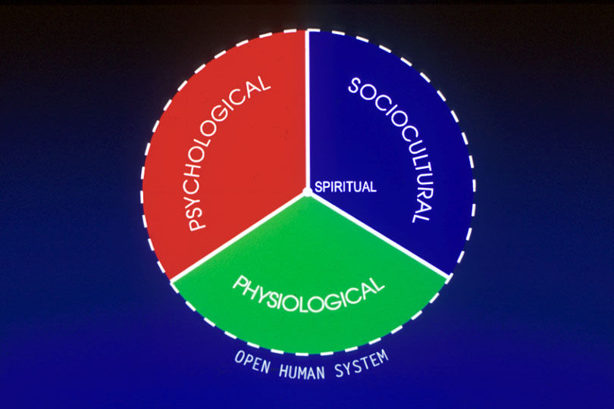

Slide 19
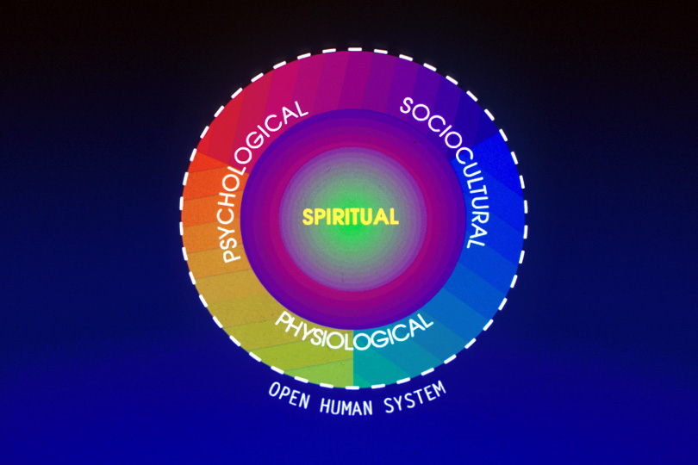

Slide 21
From our data—
Interaction with other human beings—family, community
Engaging with the environment
Compassion
Presence
Prayer
Relationship with God
Connecting

Slide 22
Interacting or connecting?
To genuinely and authentically
interact is to ‘connect’

Slide 23
Connecting in nursing practice . . .
Caring presence
Prayer
Therapeutic communication
Coordinating/managing
Mentoring, facilitating

Slide 24
In keeping with our beliefs about man . . .
Humans were created as interactive beings
that is, to interact with other human beings
And, to communicate with God

Slide 25
Ways of connecting:
Physically
Spiritually
Socially
Mentally
Emotionally
Culturally

Slide 26
Physical connectedness:
Touch (a hug, e.g.)
Skin to skin
Transfer of warmth, energy
Communicates comfort, support,
love

Slide 27
Spiritual connectedness:
Prayer
Singing
Reading scripture
Reading inspiring literature
Meditation in nature

Slide 28
Connecting with God:
“Abide in Me, and I in you. As the branch cannot bear fruit of itself, except it abide in the vine; no more can ye, except ye abide in Me”.
John 15: 4, 5

Slide 29
Connecting:
It is by our communion with Him . . . By abiding in Him that we grow in grace.
Steps to Christ, p. 50

Slide 30
Connecting:
Through sincere prayer we are brought into connection with the mind of the infinite one.
Steps to Christ, p. 73

Slide 31
Connection with nature:
The Savior’s life on earth was a life of communion with nature and with God. In this He revealed for us the secret of a life of power.
MH p. 23

Slide 32
Social connectedness:
Participating in social events
Visiting with friends
Family sharing and support
Identifying with another’s values and
attitudes

Slide 33
Mental connectedness:
Sharing ideas
Discussing topics of interest
Debating

Slide 34
Emotional connectedness:
Being empathetic, compassionate
Sharing in someone’s grief
Celebrating another’s success or joy
Loving someone very deeply

Slide 35
Cultural connectedness:
Sharing –
traditions and beliefs
language
way of dressing
holidays

Slide 36
Connectedness
Inter-connectedness
Intra-connectedness

Slide 37
Inter-connectedness . . .
First and foremost:
The interconnectedness of the entire eco- system of planet earth—the environment,
human beings, oceans, air we breathe
Not surprising: One Creator!

Slide 38
Inter-connectedness . . .
Interaction with others
Sharing grief or loss
Communication
Interdependence

Slide 39
Intra-connectedness:
Connecting with our innermost self –
Acknowledging early trauma to our self-esteem
Recognizing our fears
Understanding our motives to achieve or even compete
Identifying our search for meaning in life

Slide 40
The construct of connectedness helps us . . .
Understand human wholeness,
2. Enrich our own experience of wholeness, and
3. Improve our practice as health care
professionals.

Slide 41
Distinctiveness of our Mission:
1. Promoting wholistic well-being.
2. Restoring the connection between
humans and their Creator.
3. Promoting connectedness among
humans and their environment.

Slide 42
E.G. White refers to wholeness in two ways:
1. Wholeness of service to God
(complete dedication)
2. Holiness and perfection of character

Slide 43
Perfection . . .
Is not a condition
It is a connection

