Slide 1
Can Evolutionary theory meet the challenge of the fossil record?

Slide 2
What we know:
All complexity already present in first fossil organisms, at least at cellular level.
Nearly all phyla of animals are present in first layer containing abundant metazoan fossils.
Sedimentation studies reveal patterns that are global
Sedimentary processes appear to have been universally rapid and continuous.

Slide 3
Questions Evolutionary theory must address
Origin of Complexity
Cambrian Explosion
Fossil sequences

Slide 4
Origin of Complexity
All cellular complexity of modern organisms is present at beginning of record of fossils (Cambrian /Precambrian contact).
No proposed mechanism for origin of complexity can stand careful scrutiny.
No example of a preserved sequence of development of complex function or even a single functional protein is known.
So right from the beginning, we have no vision for an explanation apart from Creation by God.

Slide 5
Questions Evolutionary theory must address
Origin of Complexity
Cambrian Explosion
Fossil sequences

Slide 6
Cambrian Explosion
No explanation within evolutionism works.
Sudden appearance is profound.
Precambrian virtually free of metazoan life forms (Ediacara).
Every major phylum represented (few exceptions) in Lower Cambrian.
Taxa are already diverse at first appearance
Darwin says the absence of Precambrian precursor fossils is a serious challenge to his theory:
“There is another and allied difficulty, which is much more serious. I allude to the manner in which species belonging to several of the main divisions of the animal kingdom suddenly appear in the lowest known fossiliferous rocks. . . . The case at present must remain inexplicable; and may be truly urged as a valid argument against the views here entertained.”
Charles Darwin, The Origin of Species, 1902 edition, Part Two, pp. 91, 92.

Slide 7
Cambrian Explosion
At the GSA meetings in New Orleans a few years ago, a couple of papers on the Cambrian explosion were the subjects of a 'Hot topics discussion' during the noon hour. Four scientists gave brief presentations on the new ideas about the Cambrian explosion, followed by audience questions and comments. Many questions dealt with technicalities of their research method, but two questions stand out. A little background is necessary before dealing with these questions. The proposal that complex metazoan animals, ancestral to such things as molluscs, trilobites, vertebrates, sea urchins, corals, and many others, existed for a half billion years before the Cambrian implies that they lived all that time without leaving a fossil record. This pretty much requires that before the Cambrian they existed as soft worm- or larvae-like forms, with the general genetic make-up of the Cambrian groups but without their skeletonized morphology.

Slide 8
Cambrian Explosion
Now the questions. The first of the two questions was – “Why, if these animals were here for half a billion years, are trace fossils (fossil tracks, trails, and burrows) so rare before the base of the Cambrian?” An internationally recognized expert on trace fossils stood up, presumably to answer the question. However, he talked about other things and the very important question never was answered. At the end of the discussion another scientist stood up and commented on the implication that all the skeletonized phyla developed skeletons at about the same time in the Cambrian. He asked – “Why are all these types of animals living for so long and then all making skeletons all at once?” He then asked, with some vigor – “Why are you avoiding the real question?” After a pause, one member of the original presenters answered “…because it’s really hard (a hard question).” He went on to say that they hoped answers would come from further study of developmental biology.

Slide 9
Questions Evolutionary theory must address
Origin of Complexity
Cambrian Explosion
Sudden appearance of mature ecosystems
Fossil sequences

Slide 10
Example: Lower Cambrian of Nevada
Lowest Cambrian.
At least 12 species of trilobite from three orders, six families.
Salterella
Archaeocyathids
Brachiopods
Molluscs – bivalves and gastropods
Algae, trackways and burrows
Below this layer, no evidence of metazoan life

Slide 11
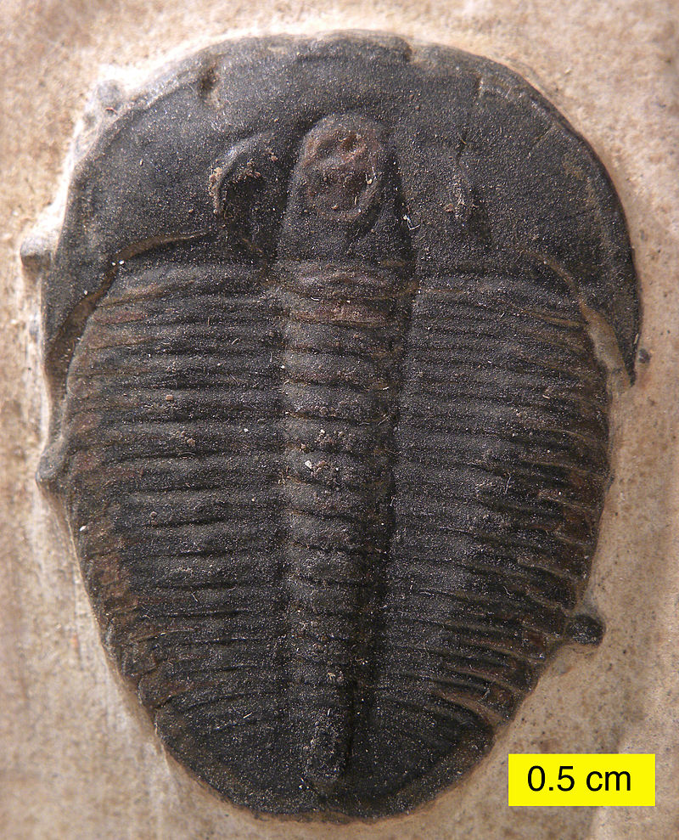
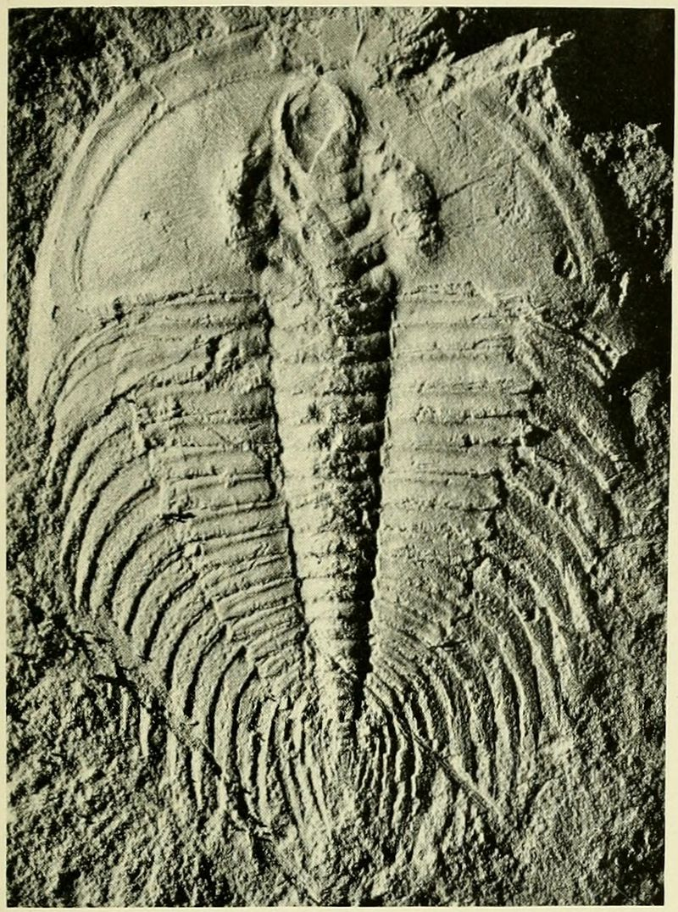
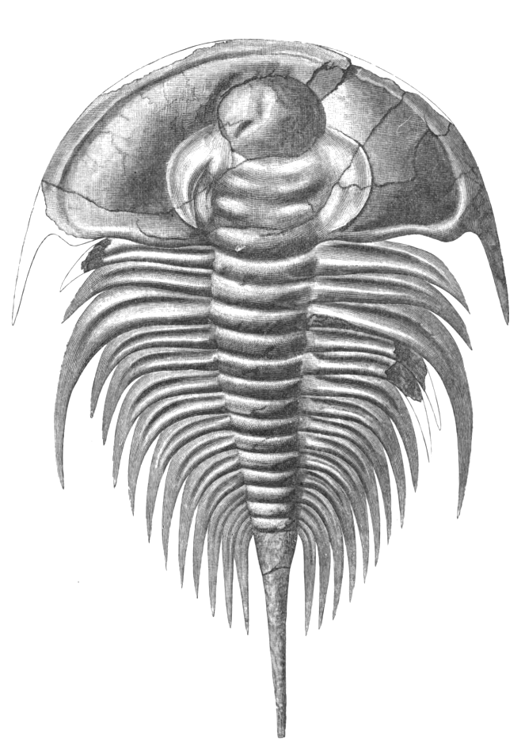
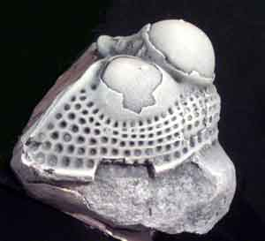
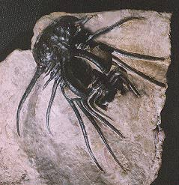
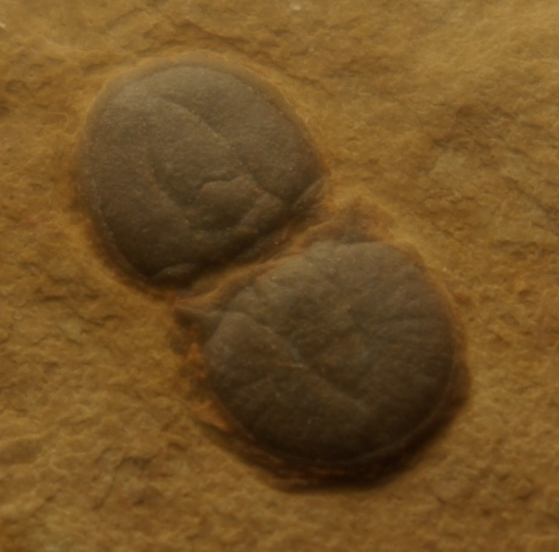
Trilobita

Slide 12
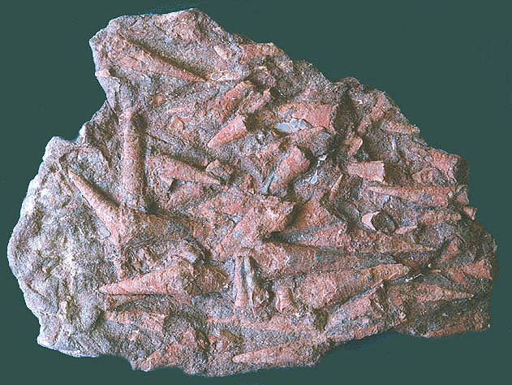
Salterella

Slide 13
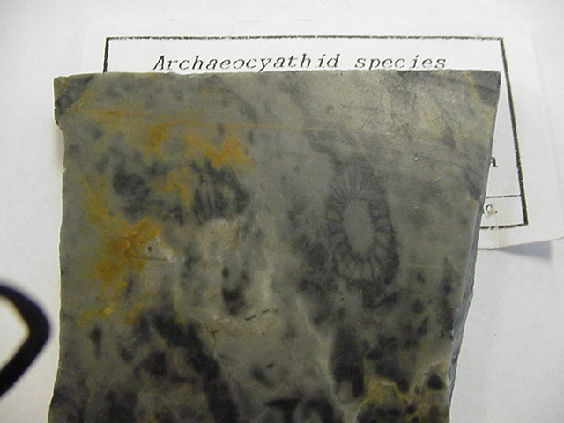
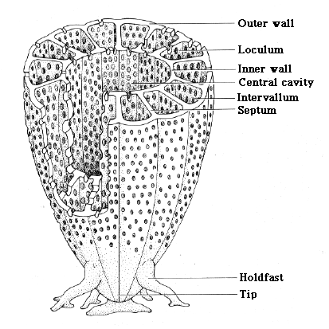
Arqueocítidos

Slide 14
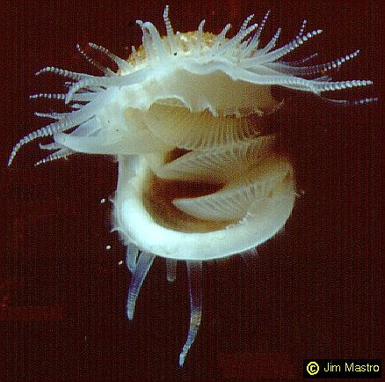
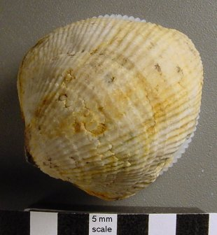
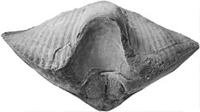
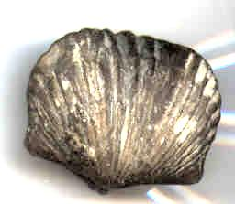
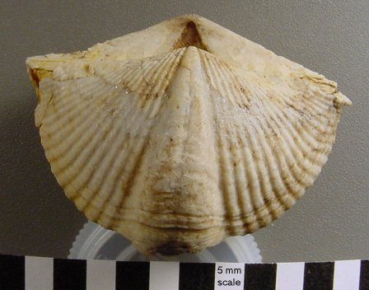
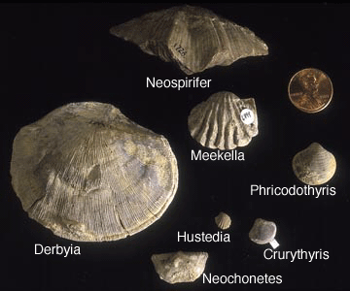
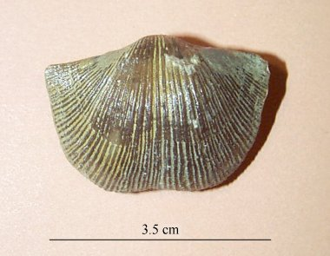
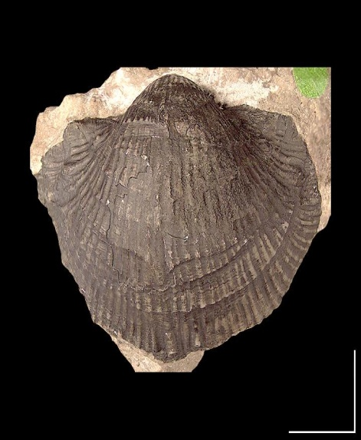
Brachiopoda

Slide 15
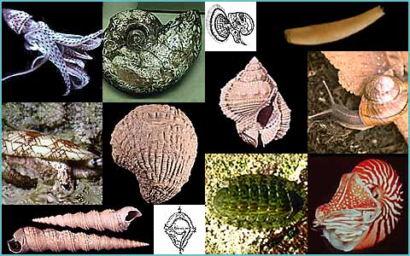
Mollusca

Slide 16
Questions evolutionary theory must address
Origin of Complexity
Cambrian Explosion
Fossil Sequences

Slide 17
Fossil Sequences
The discovery of fossil sequences has been expected and anticipated since Darwin.
“If it could be demonstrated that any complex organ existed, which could not possibly have been formed by numerous, successive, slight modifications, my theory would absolutely break down. But I can find out no such case.”
“…if the theory be true, it is indisputable that before the lowest Cambrian stratum was deposited long periods elapsed… and that during these vast periods the world swarmed with living creatures.” And “to the question why we do not find rich fossiliferous deposits belonging to these assumed earliest periods prior to the Cambrian system, I can give no satisfactory answer.” So “the case at present must remain inexplicable; and may be truly urged as a valid argument against the views here entertained.” Origin 236, 252, 254

Slide 18
Colin Patterson on fossil sequences
However, “evolutionary” sequences are profoundly missing in the fossil record. Colin Patterson, then senior paleontologist at British Museum, put it this way:
“I fully agree with your comments on the lack of direct illustration of evolutionary transitions in my book. If I knew of any, fossil or living, I would certainly have included them. You suggest that an artist should be used to visualise such transformations, but where would he get the information from? I could not, honestly, provide it, and if I were to leave it to artistic licence, would that not mislead the reader?”
He went on to say:
“Yet Gould and the American Museum people are hard to contradict when they say there are no transitional fossils. … You say that I should at least “show a photo of the fossil from which each type of organism was derived.” I will lay it on the line—there is not one such fossil for which one could make a watertight argument.”
Quoted in Sunderland, L., Darwin’s Enigma

Slide 19
Colin Patterson on fossil sequences
Theunissen, an anticreationist sceptic wrote to Patterson asking for clarification about the comments in Sunderland’s book. Patterson replied that the quote was accurate in its reproduction, but its interpretation was faulty because he had also written:
“The reason is that statements about ancestry and descent are not applicable in the fossil record. Is Archaeopteryx the ancestor of all birds? Perhaps yes, perhaps no: there is no way of answering the question.”

Slide 20
Fossil Sequences
What about the proclaimed series of fossils? Similar to situation with Peppered Moth.
Hominid fossils
Protohorses to horses
Synapsids to mammals
Dinosaurs to birds
Fish to tetrapods
Land mammals to whales
Perhaps some others

Slide 21
Raup on Fossil Sequences
David Raup has stated:
"Well, we are now about 120 years after Darwin and the knowledge of the fossil record has been greatly expanded. We now have a quarter of a million fossil species but the situation hasn't changed much. The record of evolution is still surprisingly jerky and, ironically, we have even fewer examples of evolutionary transitions than we had in Darwin's time. By this I mean that some of the classic cases of Darwinian change in the fossil record, such as the evolution of the horse in North America, have had to be discarded or modified as a result of more detailed information -- what appeared to be a nice simple progression when relatively few data were available now appears to be much more complex and much less gradualistic."
"Conflicts Between Darwin and Paleontology," Bulletin, Field Museum of Natural History, January 1979,50:22- 29.

Slide 22
Gould on Transitional forms
"The extreme rarity of transitional forms is the trade secret of paleontology ... The history of most fossil species includes two features particularly inconsistent with gradualism: 1. Stasis. Most species exhibit no directional change during their tenure on earth. They appear in the fossil record looking much the same as when they disappear; morphological change is usually limited and directionless. 2. Sudden appearance. In any local area, a species does not arise gradually by the steady transformation of its ancestors; it appears all at once and 'fully formed.'" [S.J. Gould; Natural History 86:14 (1977)]

Slide 23
Donald Prothero on stasis
In my dissertation on the incredibly abundant and well preserved fossil mammals of the …High Plains, I had over 160 well-dated, well-sampled lineages of mammals, so I could evaluate the relative frequency of gradualism versus stasis in an entire regional fauna. I also had a wide geographic spread (from Montana and Saskatchewan to Texas…). I had large fossil samples of many species, with dozens at each level, and excellent stratigraphic data. When I …analyzed my data carefully, it was clear that nearly every lineage showed stasis, with one minor example of gradual size reduction in the little oreodont Miniochoerus. I could point to this data set and make the case for the prevalence of stasis without any criticism of bias in my sampling. More importantly, the fossil mammals showed no sign of responding to the biggest climate change of the past 50 million years ... out of all the 160 lineages of mammals in this time interval, there was virtually no response.

Slide 24
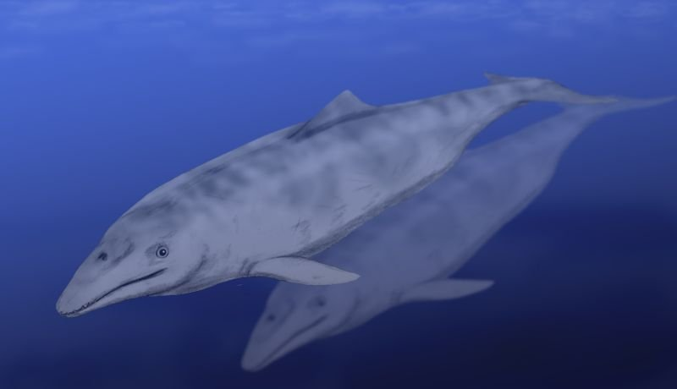
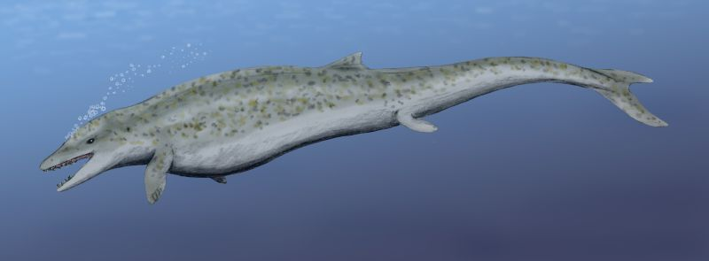
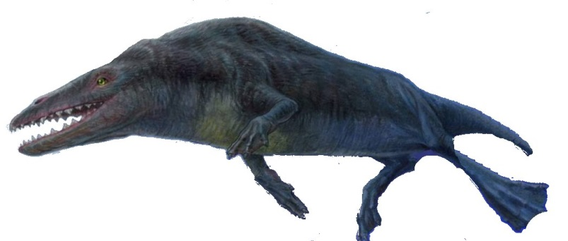
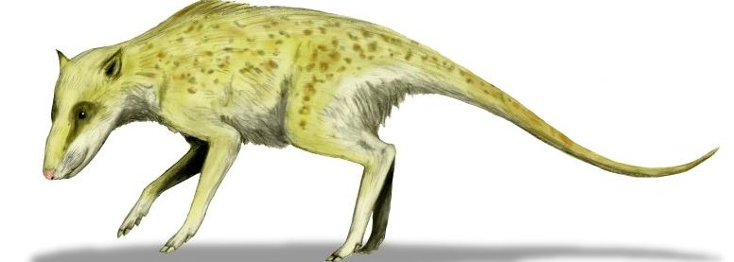
Fossil order
Systematic order
Aetiocetus
25
40
Dorudon
Basilosaurus
Time
(MYBP)
Maiacetus
45
Rhodhocetus
47
48
Ambulocetus
50
Pakicetus
52
Indohyus

Slide 25
Questions evolutionary theory must address
Origin of Complexity – No evidentiary pathway for origin of even one functional protein, say nothing of a single motor, machine, or factory.
Cambrian Explosion – No mechanism or evidentiary explanation for the arrival of all of the phyla in the Lower Cambrian.
Fossil Sequences – No evidentiary sequence for even a single organism, with a step-by-step, gene by gene transition from its posited ancestor.

Slide 26
Conclusions:
.The origin of complexity continues to be an intractable challenge to the Standard Model, even though adherents may not be aware of it.
The few posited fossil relationships are sensible enough if you are not challenging the Standard Model, but do not hold up to careful scrutiny or critical analysis if investigated closely.
Evolutionary theory does not and apparently cannot, in its present form, meet the challenge of the fossil record.

Slide 27
Can Evolutionary theory meet the challenge of the fossil record?
Origin of Complexity
Cambrian Explosion
Fossil sequences

Slide 28
Can Evolutionary theory meet the challenge of the fossil record?
Origin of Complexity - - -NO!
Cambrian Explosion
Fossil sequences

Slide 29
Can Evolutionary theory meet the challenge of the fossil record?
Origin of Complexity - - - NO!
Cambrian Explosion
Fossil sequences

Slide 30
Can Evolutionary theory meet the challenge of the fossil record?
Origin of Complexity - - - NO!
Cambrian Explosion - - - NO!
Fossil sequences

Slide 31
Can Evolutionary theory meet the challenge of the fossil record?
Origin of Complexity - - - NO!
Cambrian Explosion - - - NO!
Fossil Sequences

Slide 32
Can Evolutionary theory meet the challenge of the fossil record?
Origin of Complexity - - - NO!
Cambrian Explosion - - - NO!
Fossil Sequences - - - NO!

Slide 33
Can Evolutionary theory meet the challenge of the fossil record?
Origin of Complexity - - - NO!
Cambrian Explosion - - - NO!
Fossil Sequences - - - NO!

