Slide 1


Slide 2
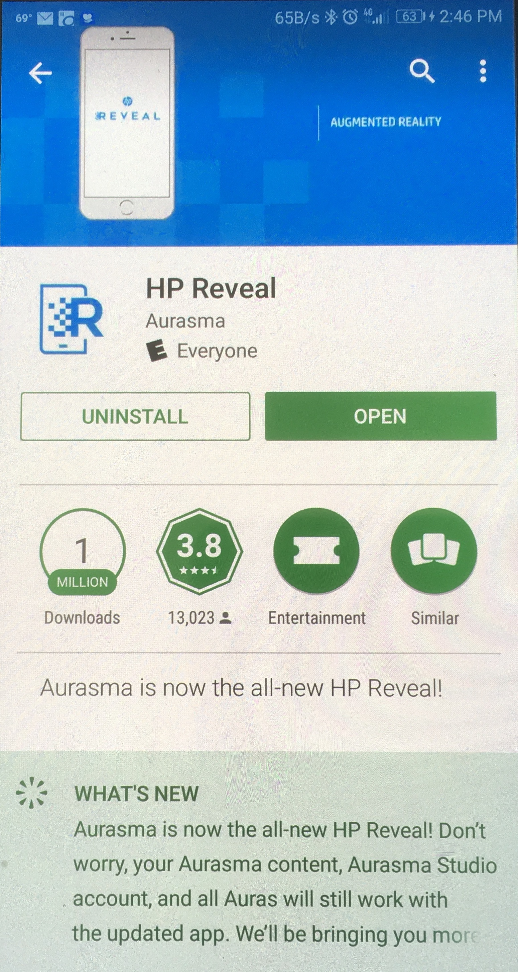
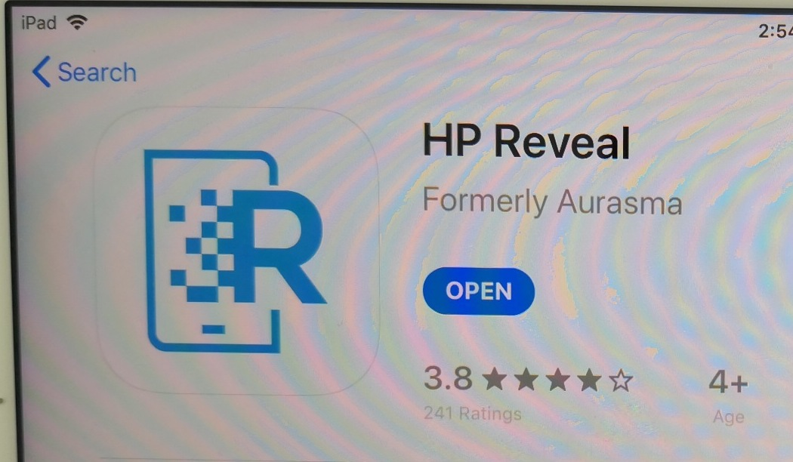
Augmented Reality
Réalité Augmentée
Tablets or Smartphones
Please Download the app Now
Télécharger l’ application maintenant
HP Reveal
Android
Apple
Notes:
Don’t Open it yet!

Slide 3

EXSEED
EXcellence in STEM Experiential EDucation
EXcellence en STEM Expérientiel ÉDucation
Science Technology Engineering Math
STEM Inspiration and Excitement

Slide 4
Augmented Reality
Réalité Augmentée
Display Digital information while pointing your smartphone, tablet, or AR Glasses at a real (physical) object
Augment, or add to digitally, what is real, that is, what you see
Example: hold your camera over a photo of a person and watch a video about that person
Example: point your camera at an item in a store and watch a video with the details of that item
Examples:

Slide 5


Slide 6
Demos
Doug’s Business Card
US $1 Bill
US $20 Bill

Slide 7
Augmented reality, a set of technologies that superimposes digital data and images on the physical world, promises to release untapped and uniquely human capabilities.
Though still in its infancy, AR is poised to enter the mainstream; according to one estimate, spending on AR technology will hit $60 billion in 2020. AR will
affect companies in every industry and many other types of organizations, from universities to social enterprises. In the coming months and years, it will transform how we learn, make decisions, and interact with the physical world. It will also change how enterprises serve customers, train employees, design and create products, and manage their value chains, and, ultimately, how they compete.

Slide 8
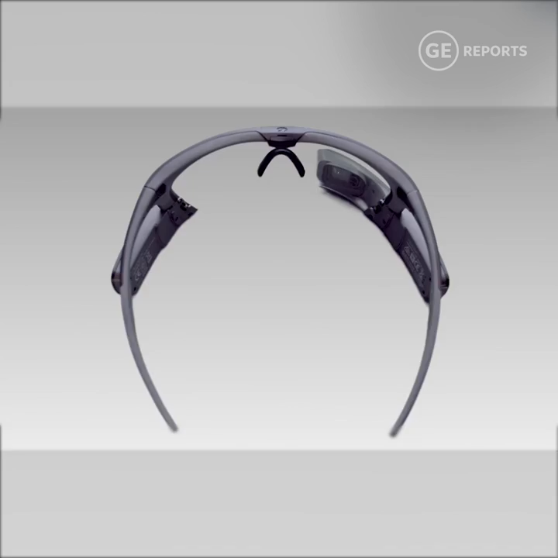
Augmented Reality for Industry

Slide 9
Teaching with Augmented Reality
Enseignment avec Réalité Augmentée
Multidisciplinary Multidisciplinaire
Project Based Learning l’ apprentissage par projet
Flipped Classroom Classe inversée
Algebra Demonstration Algèbre Démonstration
Notes:
Photo “Algebra text for AR example”
Photo on my smartphone

Slide 10
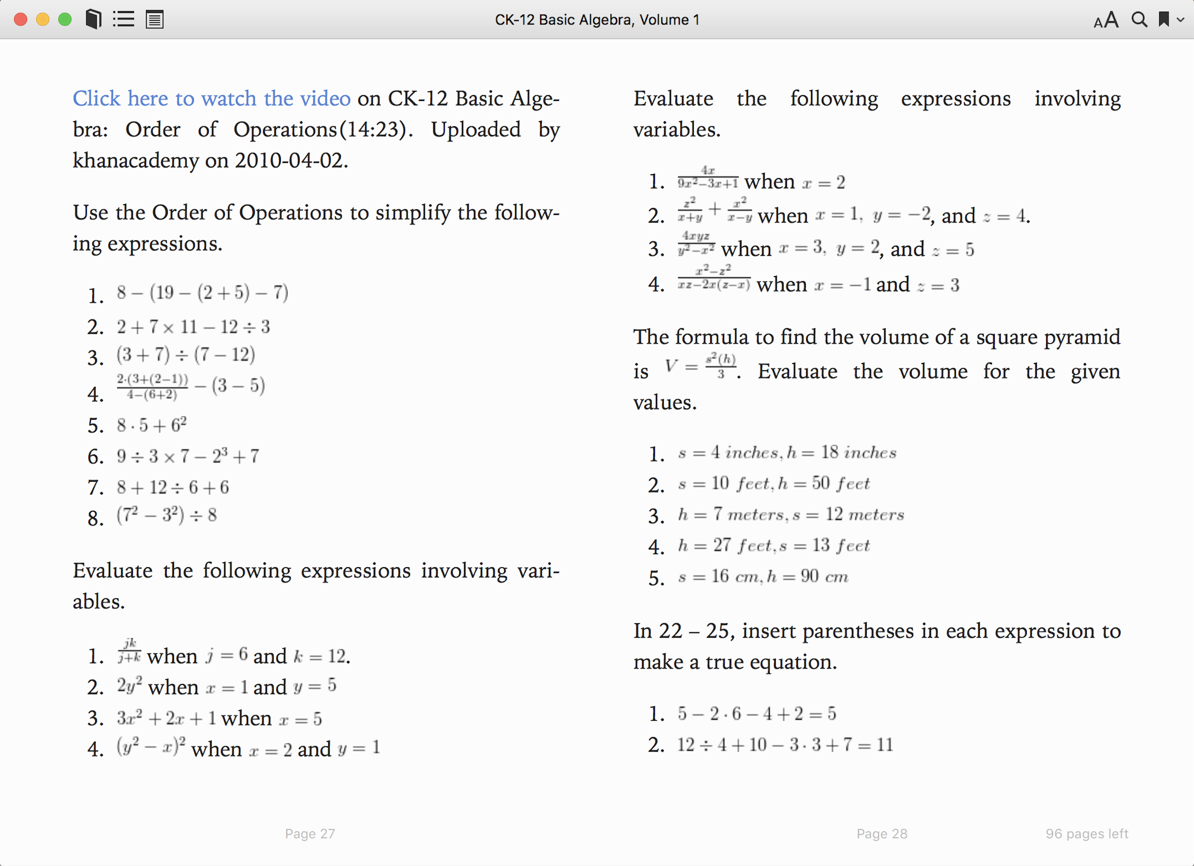

Slide 11
https://www.khanacademy.org/math/pre-algebra/pre-algebra-arith-prop/pre-algebra-order-of-operations/v/more-complicated-order-of-operations-example

Slide 12
Please Download this app now
Télécharger l’ application maintenant
HP Reveal
Tablet or Smartphone
Android or Apple
Android
Apple

Slide 13
Vocabulary
Aura
Trigger
Overlay

Slide 14
Aura
The Finished Product
A Video, PPT, Text that displays on a tablet, smartphone, AR Glasses when the app is open and the camera is held over a photo or an object

Slide 15
Two Parts
Overlay
  You make a video that will display when your camera is aimed at the trigger image
  Include video clips, PowerPoint, still shots, narration, music, anything you want
Trigger Image
  Any thing you want to photograph
  This will be where you aim your phone or tablet camera to start your Aura
  Flat object is best

Slide 16
Let your students be creative
Any Subject
Any Reason
Any Trigger
Any Video

Slide 17
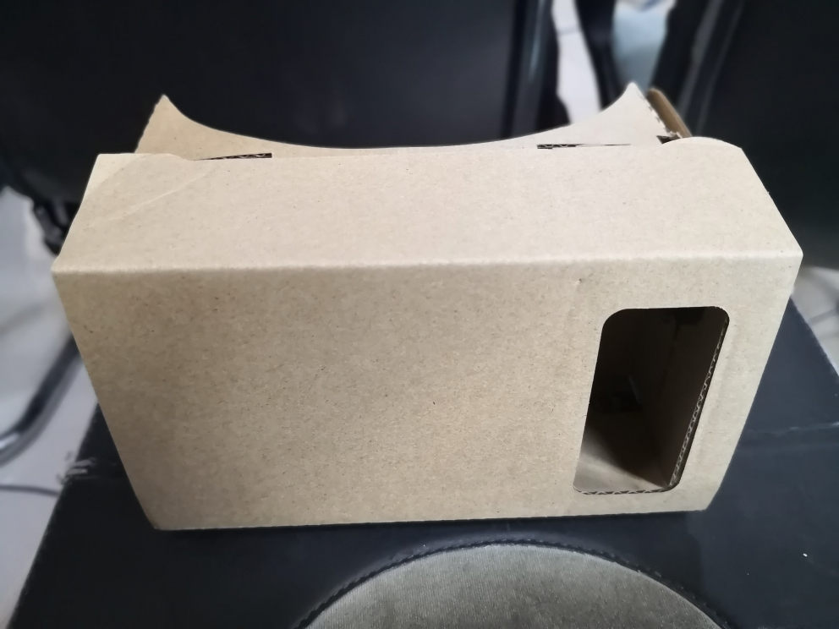
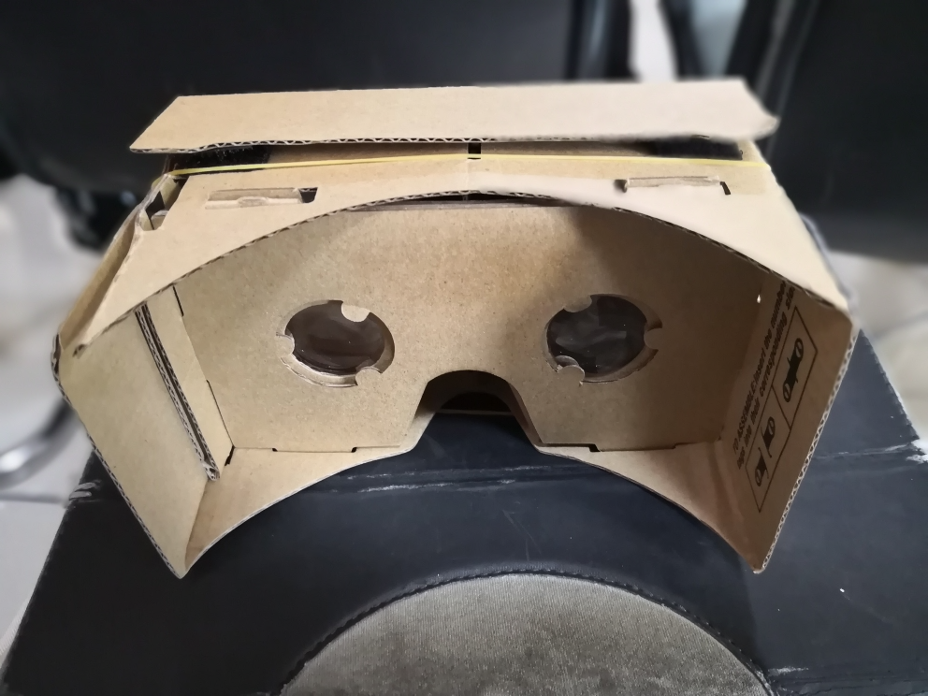
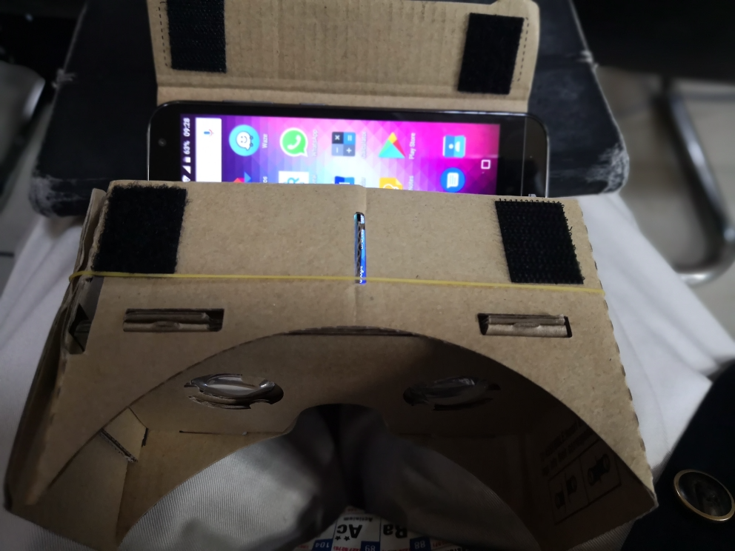
Virtual Reality Réalité Virtuelle
Google Cardboard
Early Headsets cost US$ 12,000.00
These cost US$ 1.00
Notes:
I can demonstrate this during breaks, etc.

Slide 18

QR Code for a Rwanda Newspaper

Slide 19
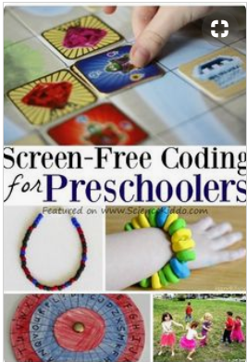
Kindergarten (K/TK/PK) is the first stage
Kindergarten students learn to code
Scratch Jr. or other block coding
  Computer, tablet, smartphone
Coding without a screen
  No computer, tablet or other screen required
  Wood blocks, beads, etc.
Notes:
Elementary school

Slide 20
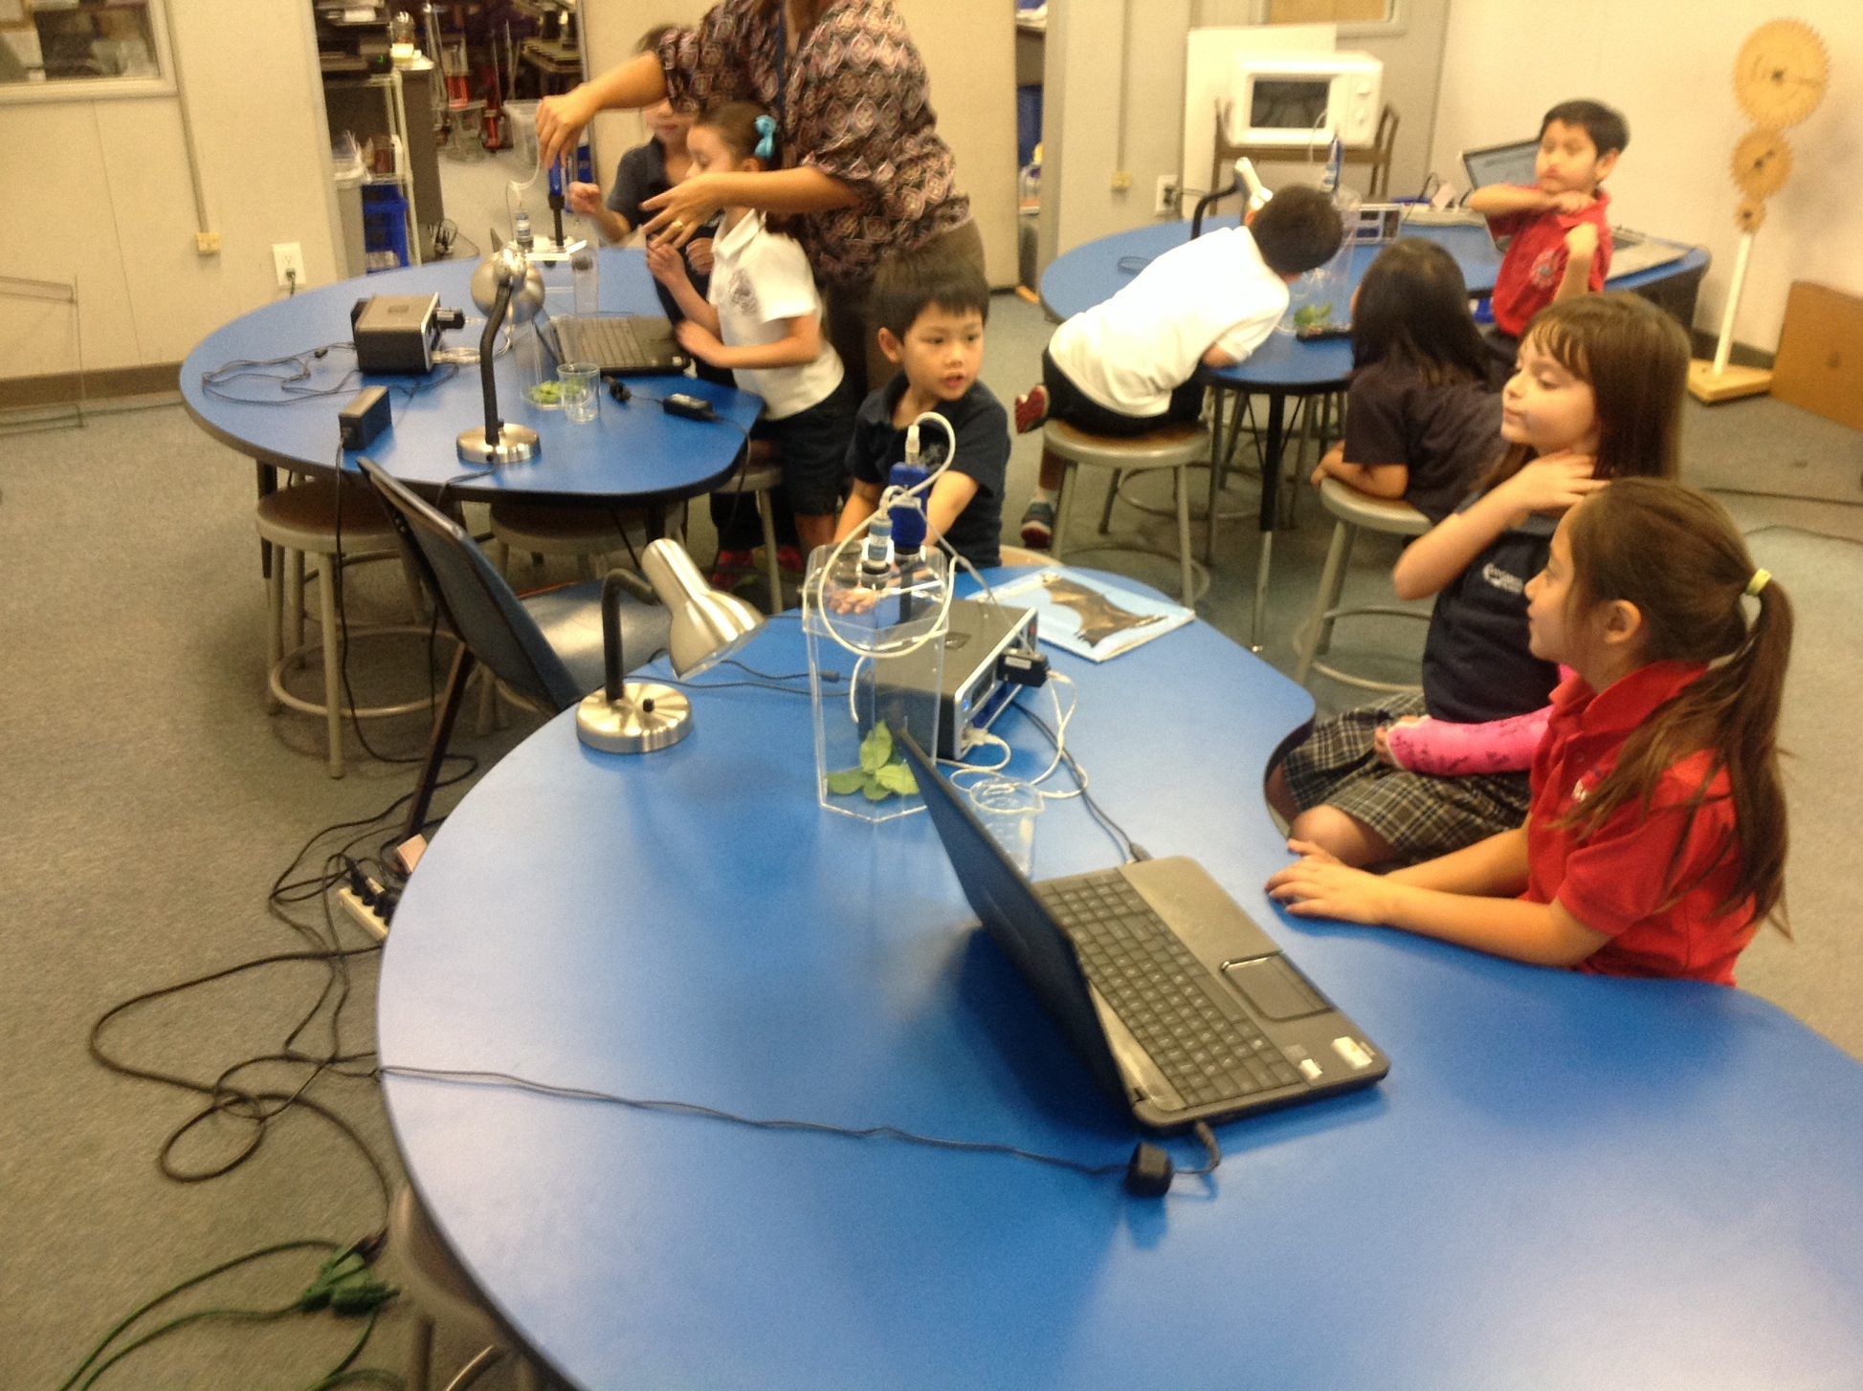
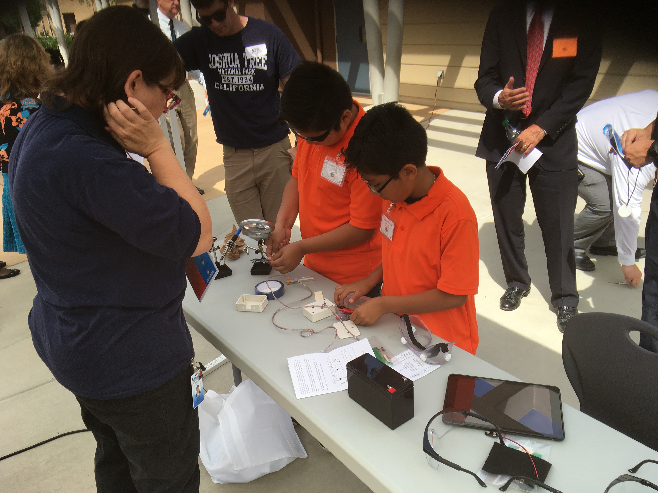
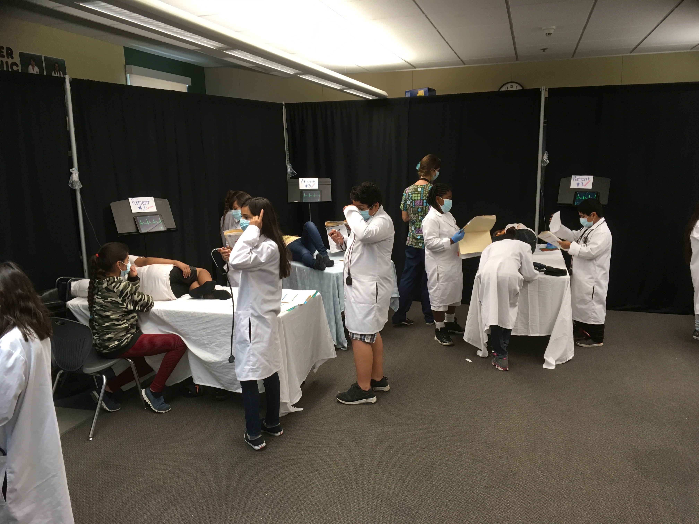
Elementary School
Notes:
Middle School

Slide 21
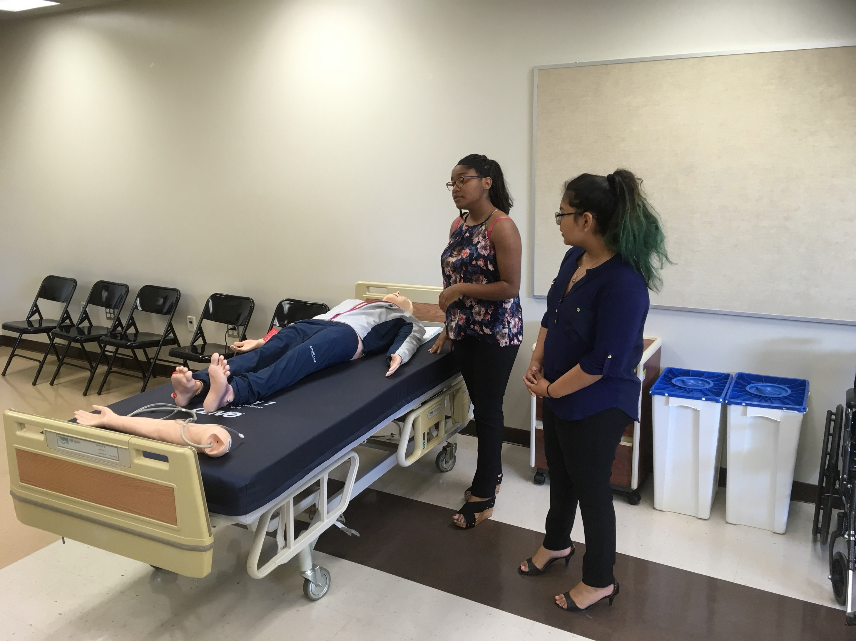
ISHS Health Academy Lab

Slide 22
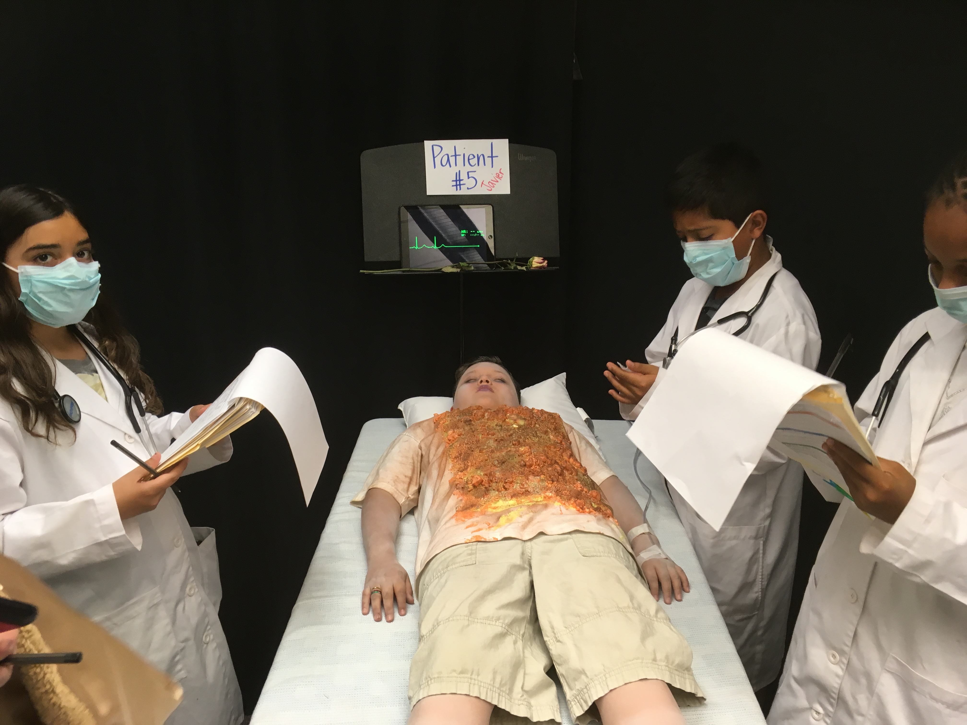
Bing Wong Elementary School
Health Pathway iCARE Lab

Slide 23
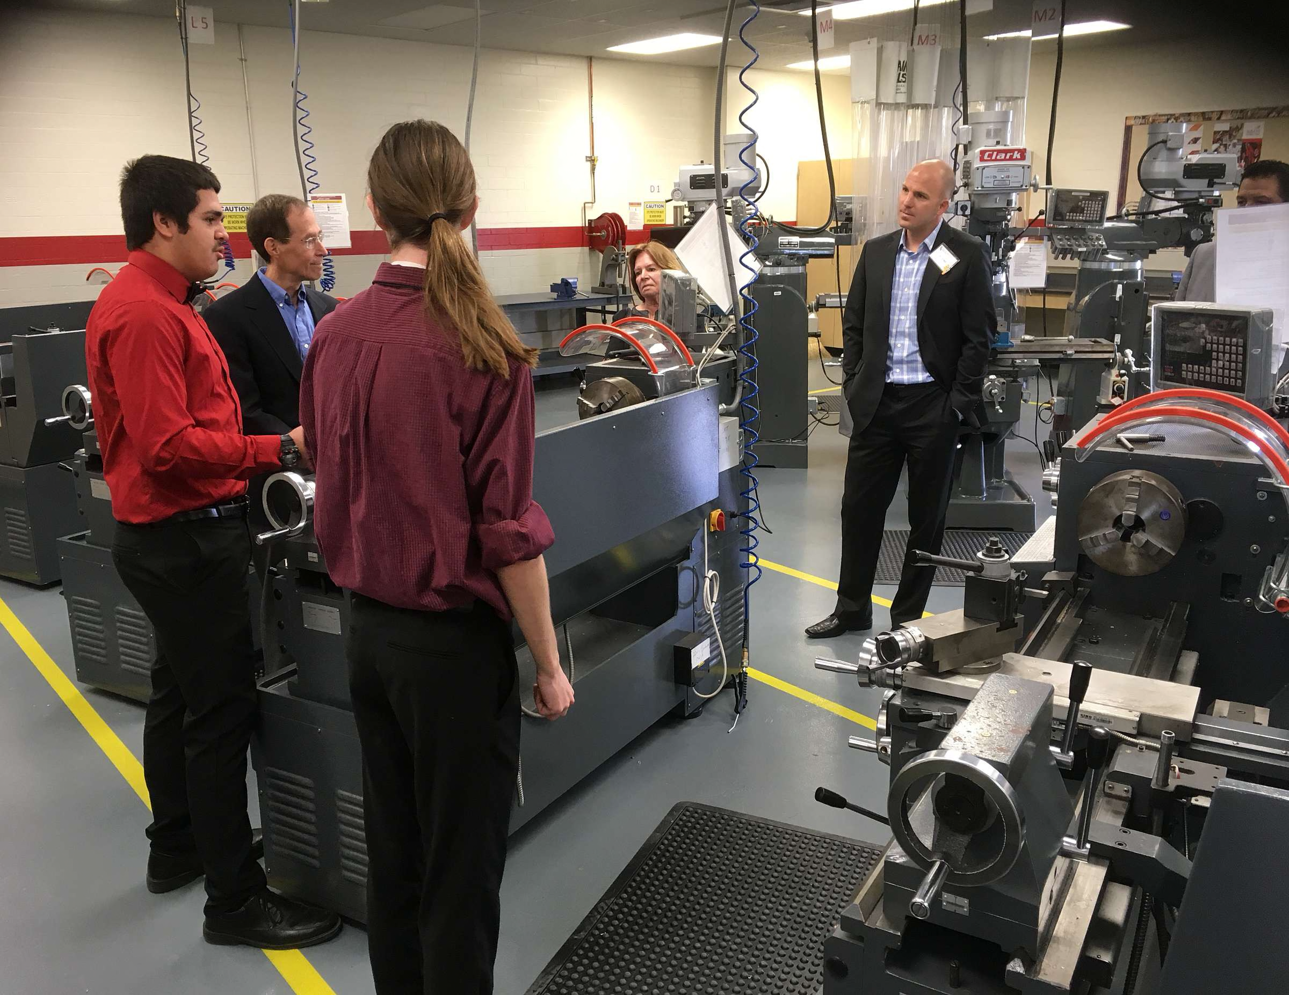
High School Machine Academy Lab

Slide 24
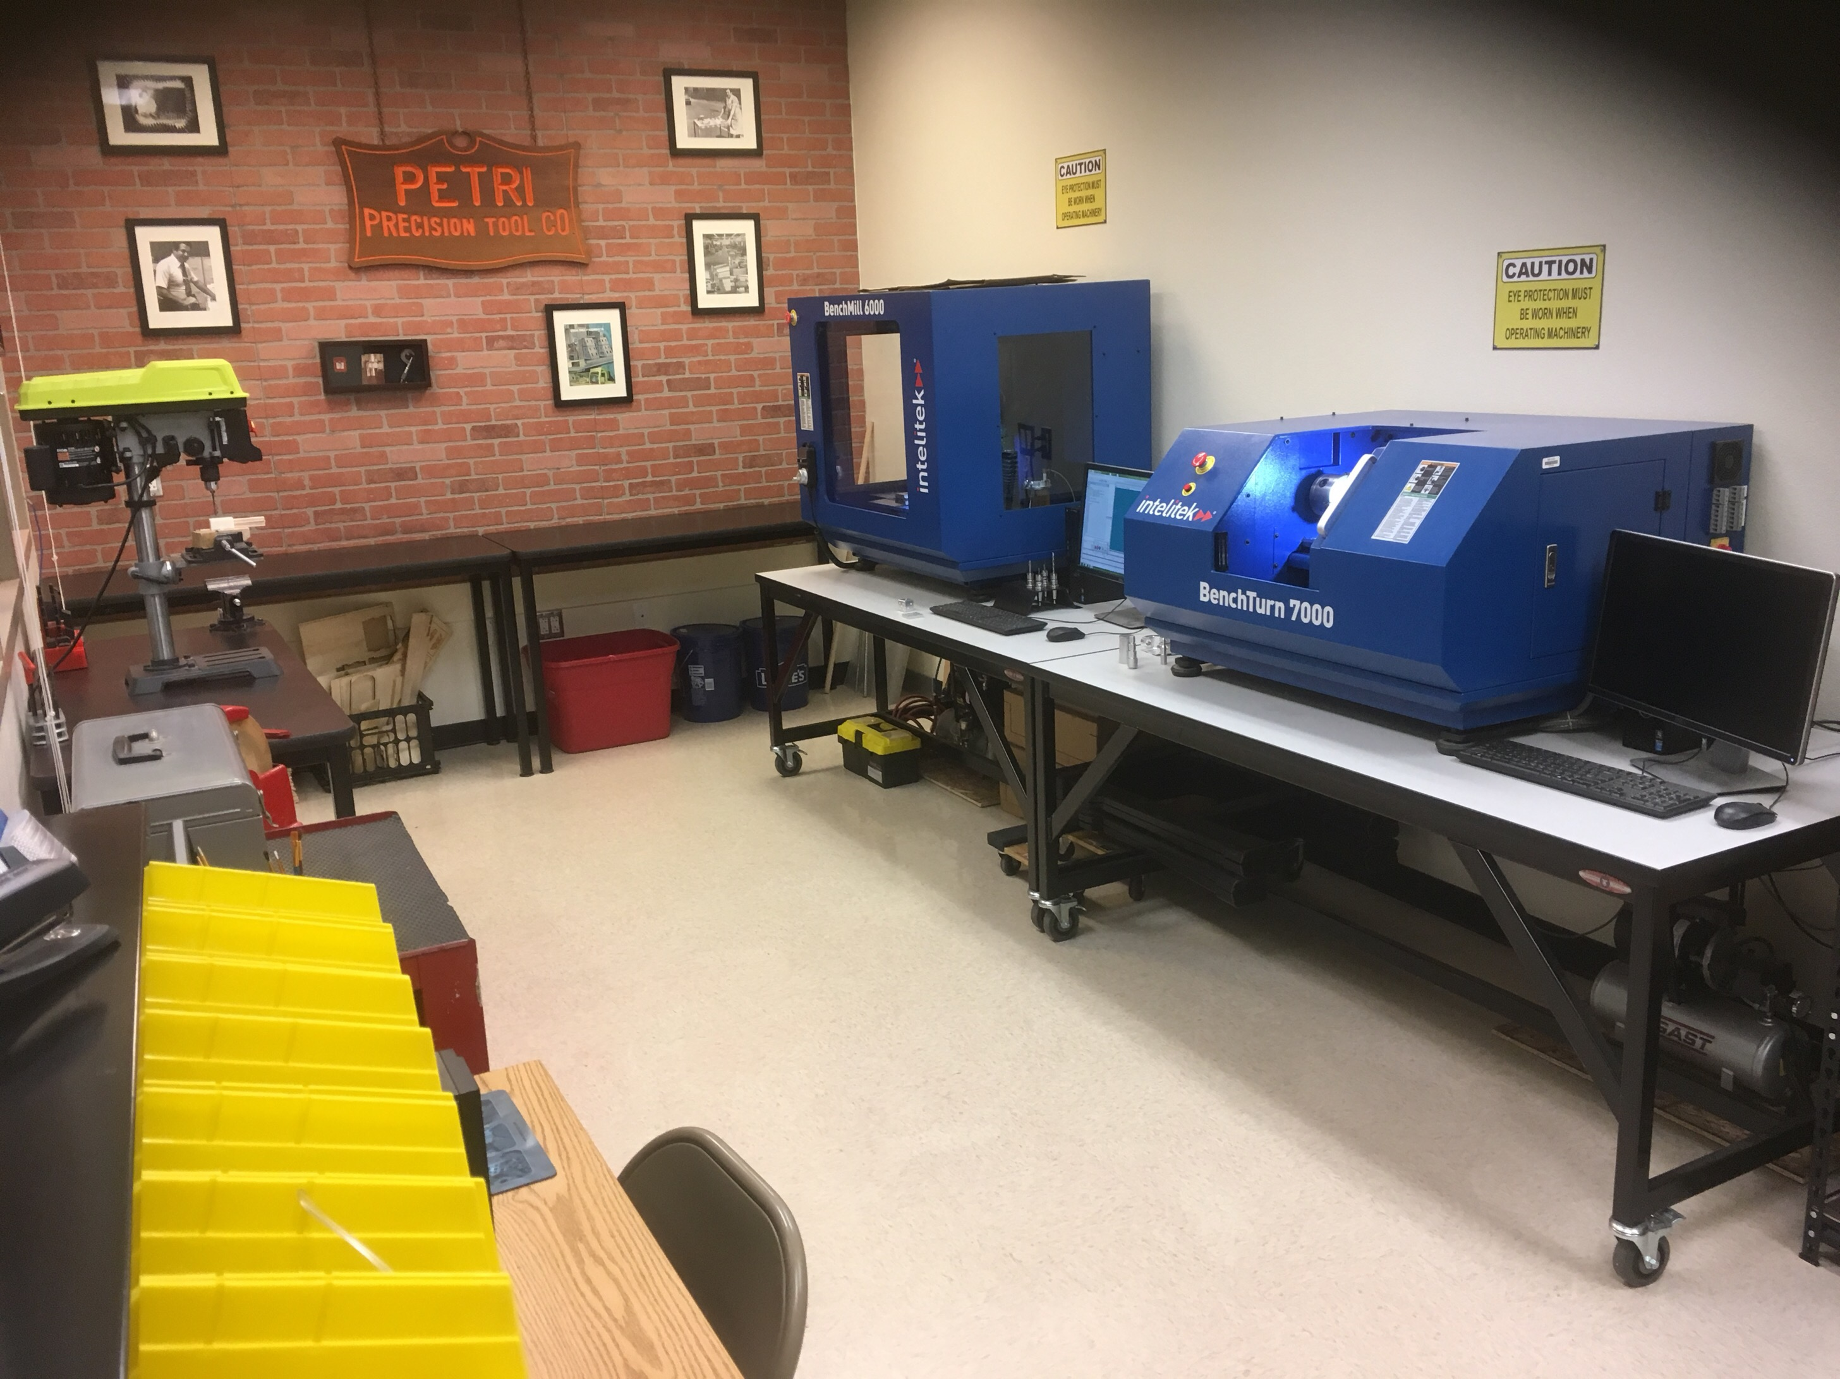
Elementary School STEM Lab

Slide 25

By Design: Elementary Science http://www.bydesignlabs.org/home/

Slide 26
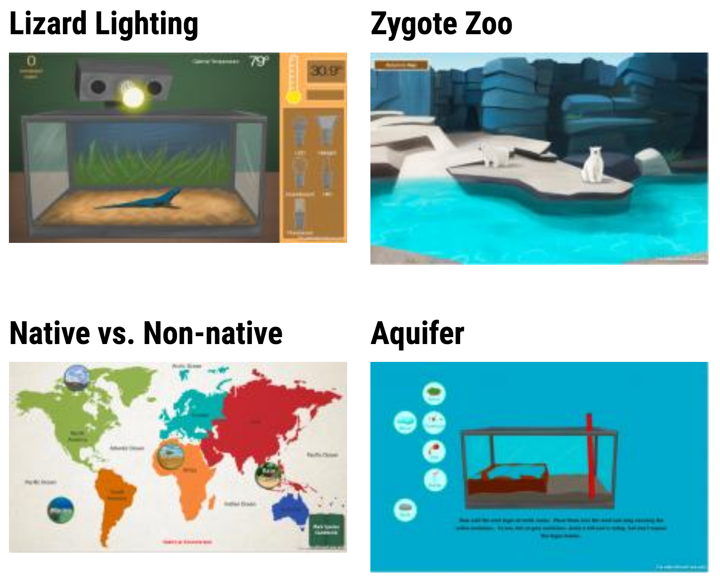
Sample Labs

Slide 27
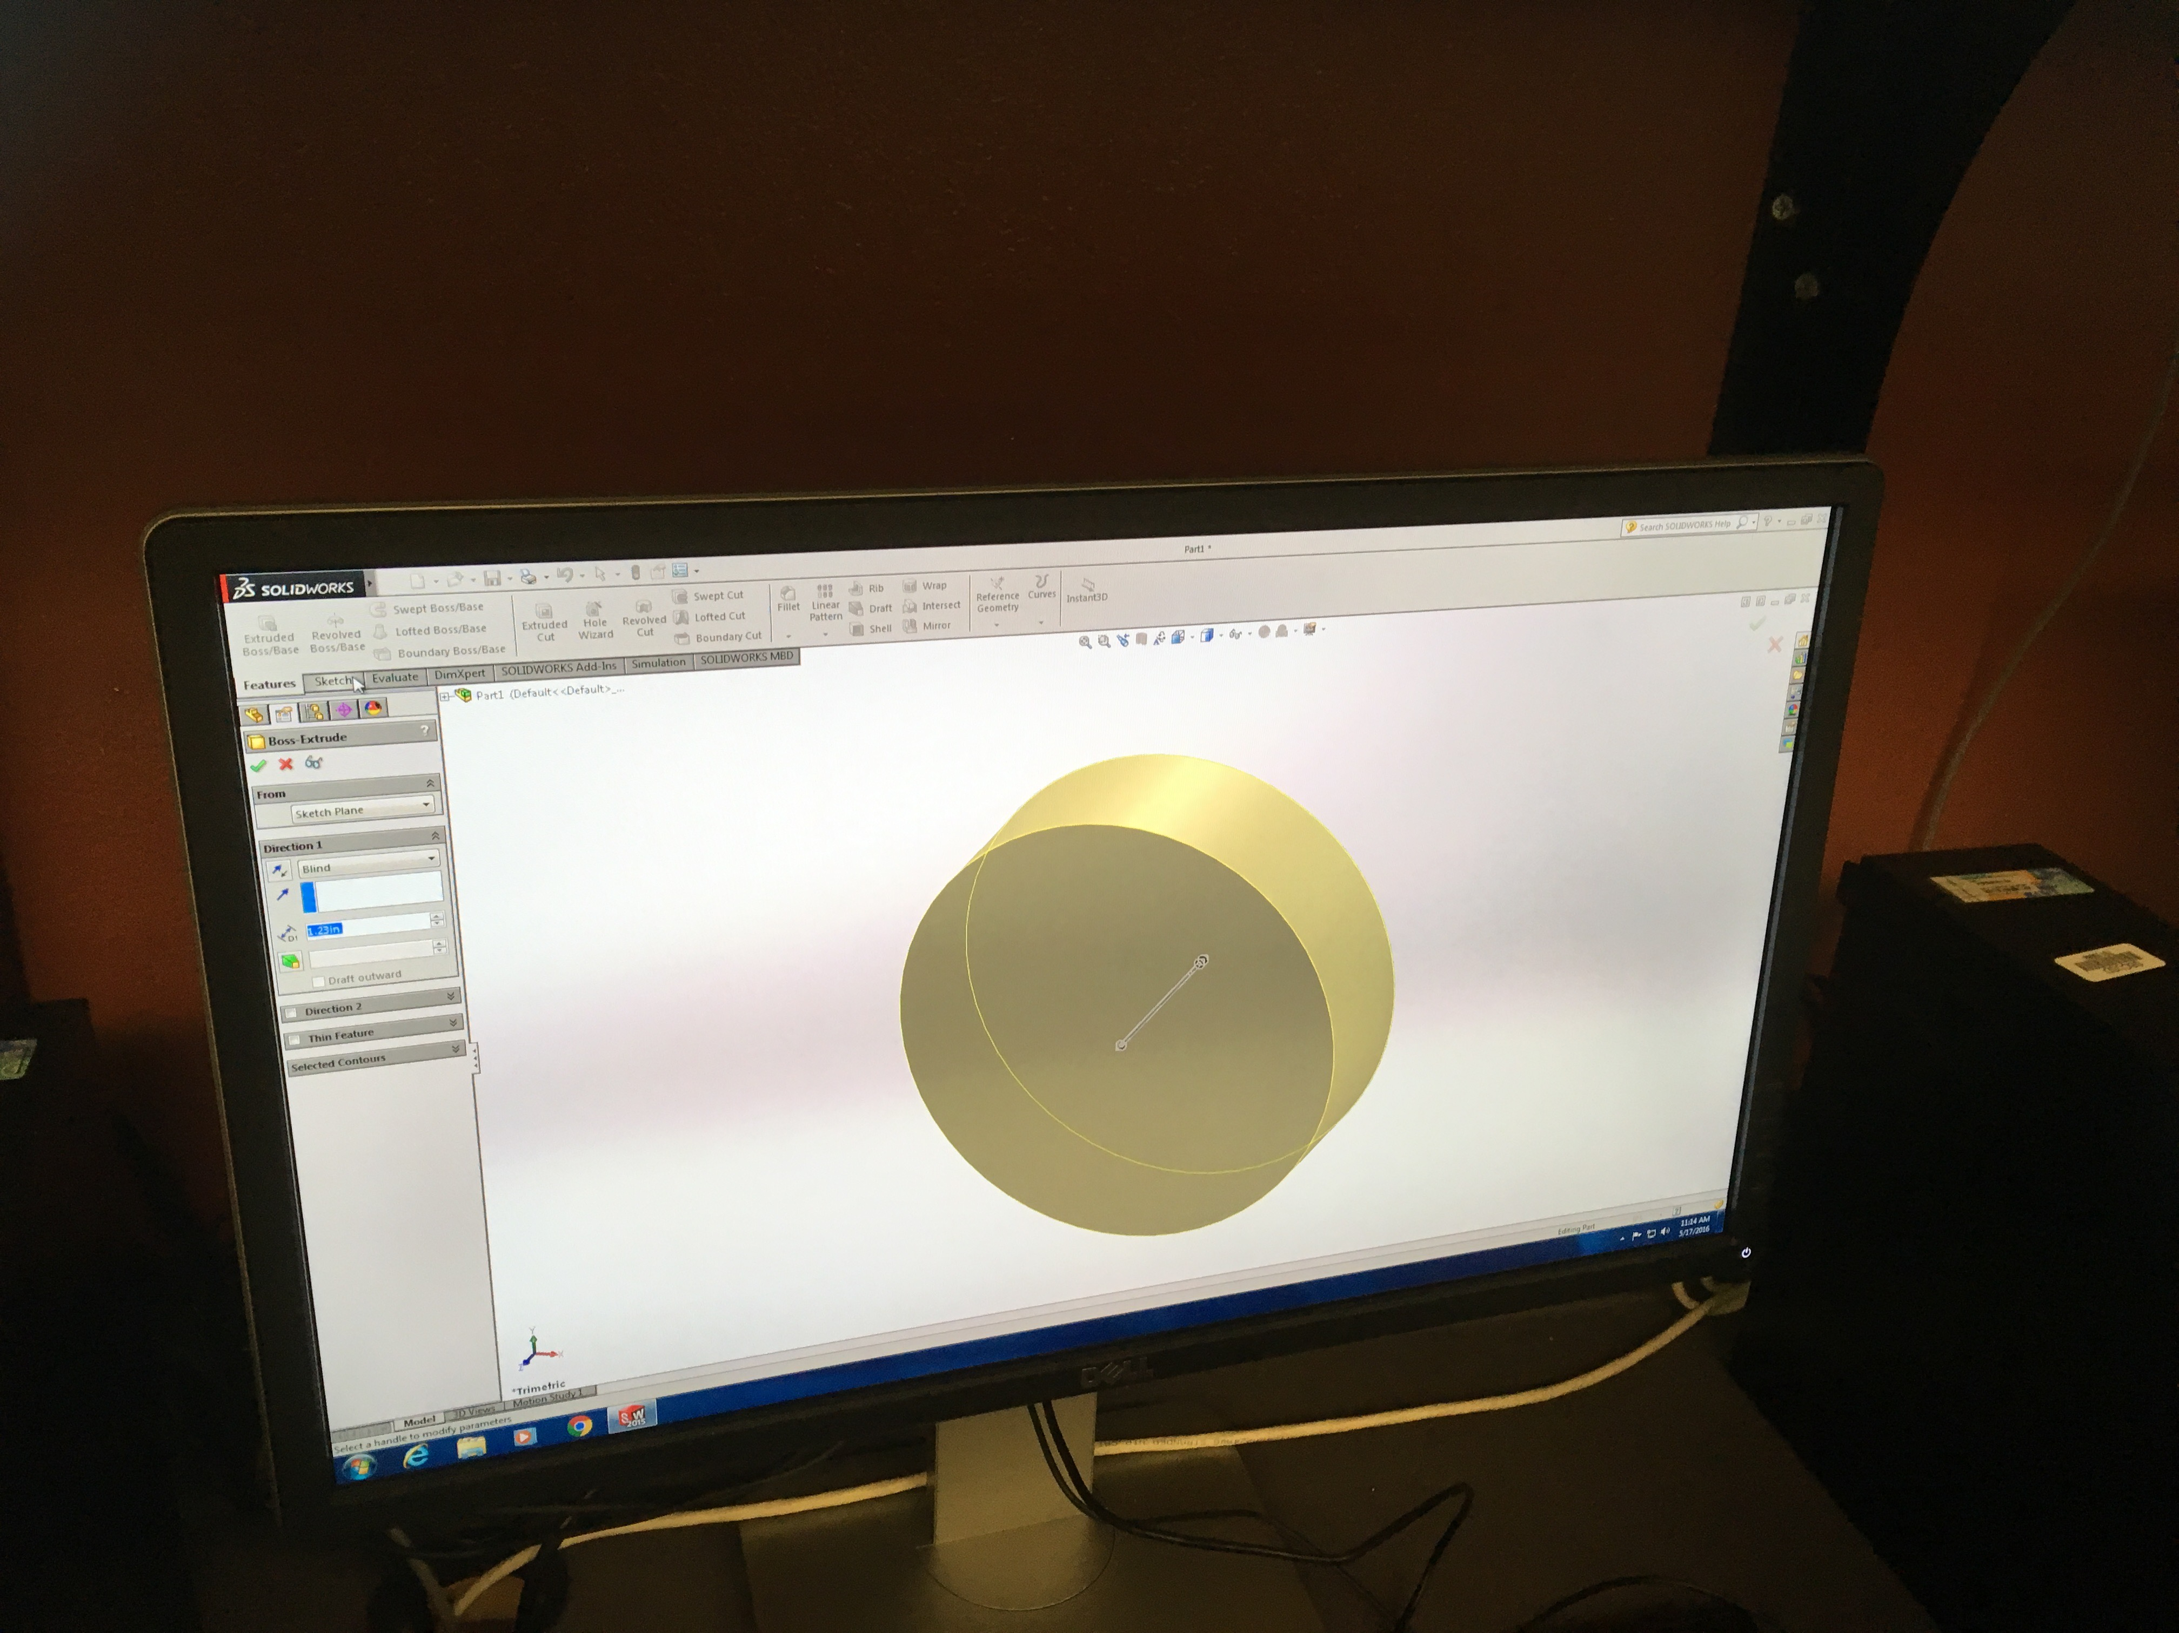
5th Grade CAD Project

Slide 28
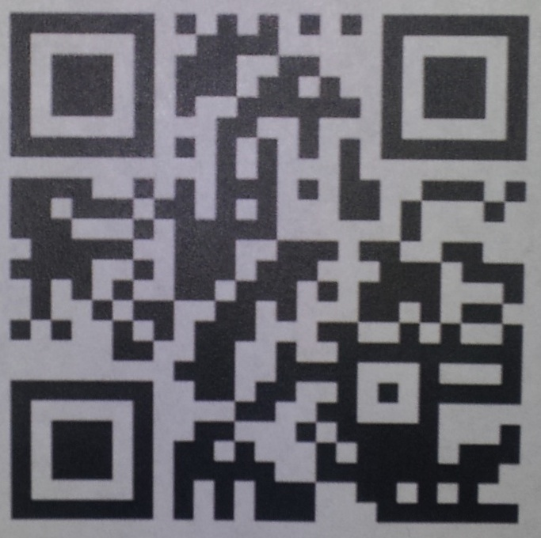
EXSEED 2019 June 17-21
Douglas Havens
Director of EXSEED
Loma Linda University
dhavens@llu.edu
exseed@llu.edu
www.llu.edu/exseed

