Slide 1
Analyzing Arguments
Suzanne Phillips
Loma Linda University
Loma Linda, CA

Slide 2
Bible “Scientists”
History of Individuals Challenged with Data that Contradicted the Word of God
Eve
Noah

Slide 3
The story of Yellowstone “Fossil Forests”
Late 1800’s Fossil Forests of Yellowstone National Park were discovered and study began.
Concluded many generations of forests grew and then were successively destroyed by volcanic catastrophes over many tens of thousands of years.
Recognized as a problem for the Adventist view of earth history.
Caused many to lose their confidence in God’s word, and some left the Adventist Church.
Some others began research on the Fossil trees to see what further research might reveal.

Slide 4
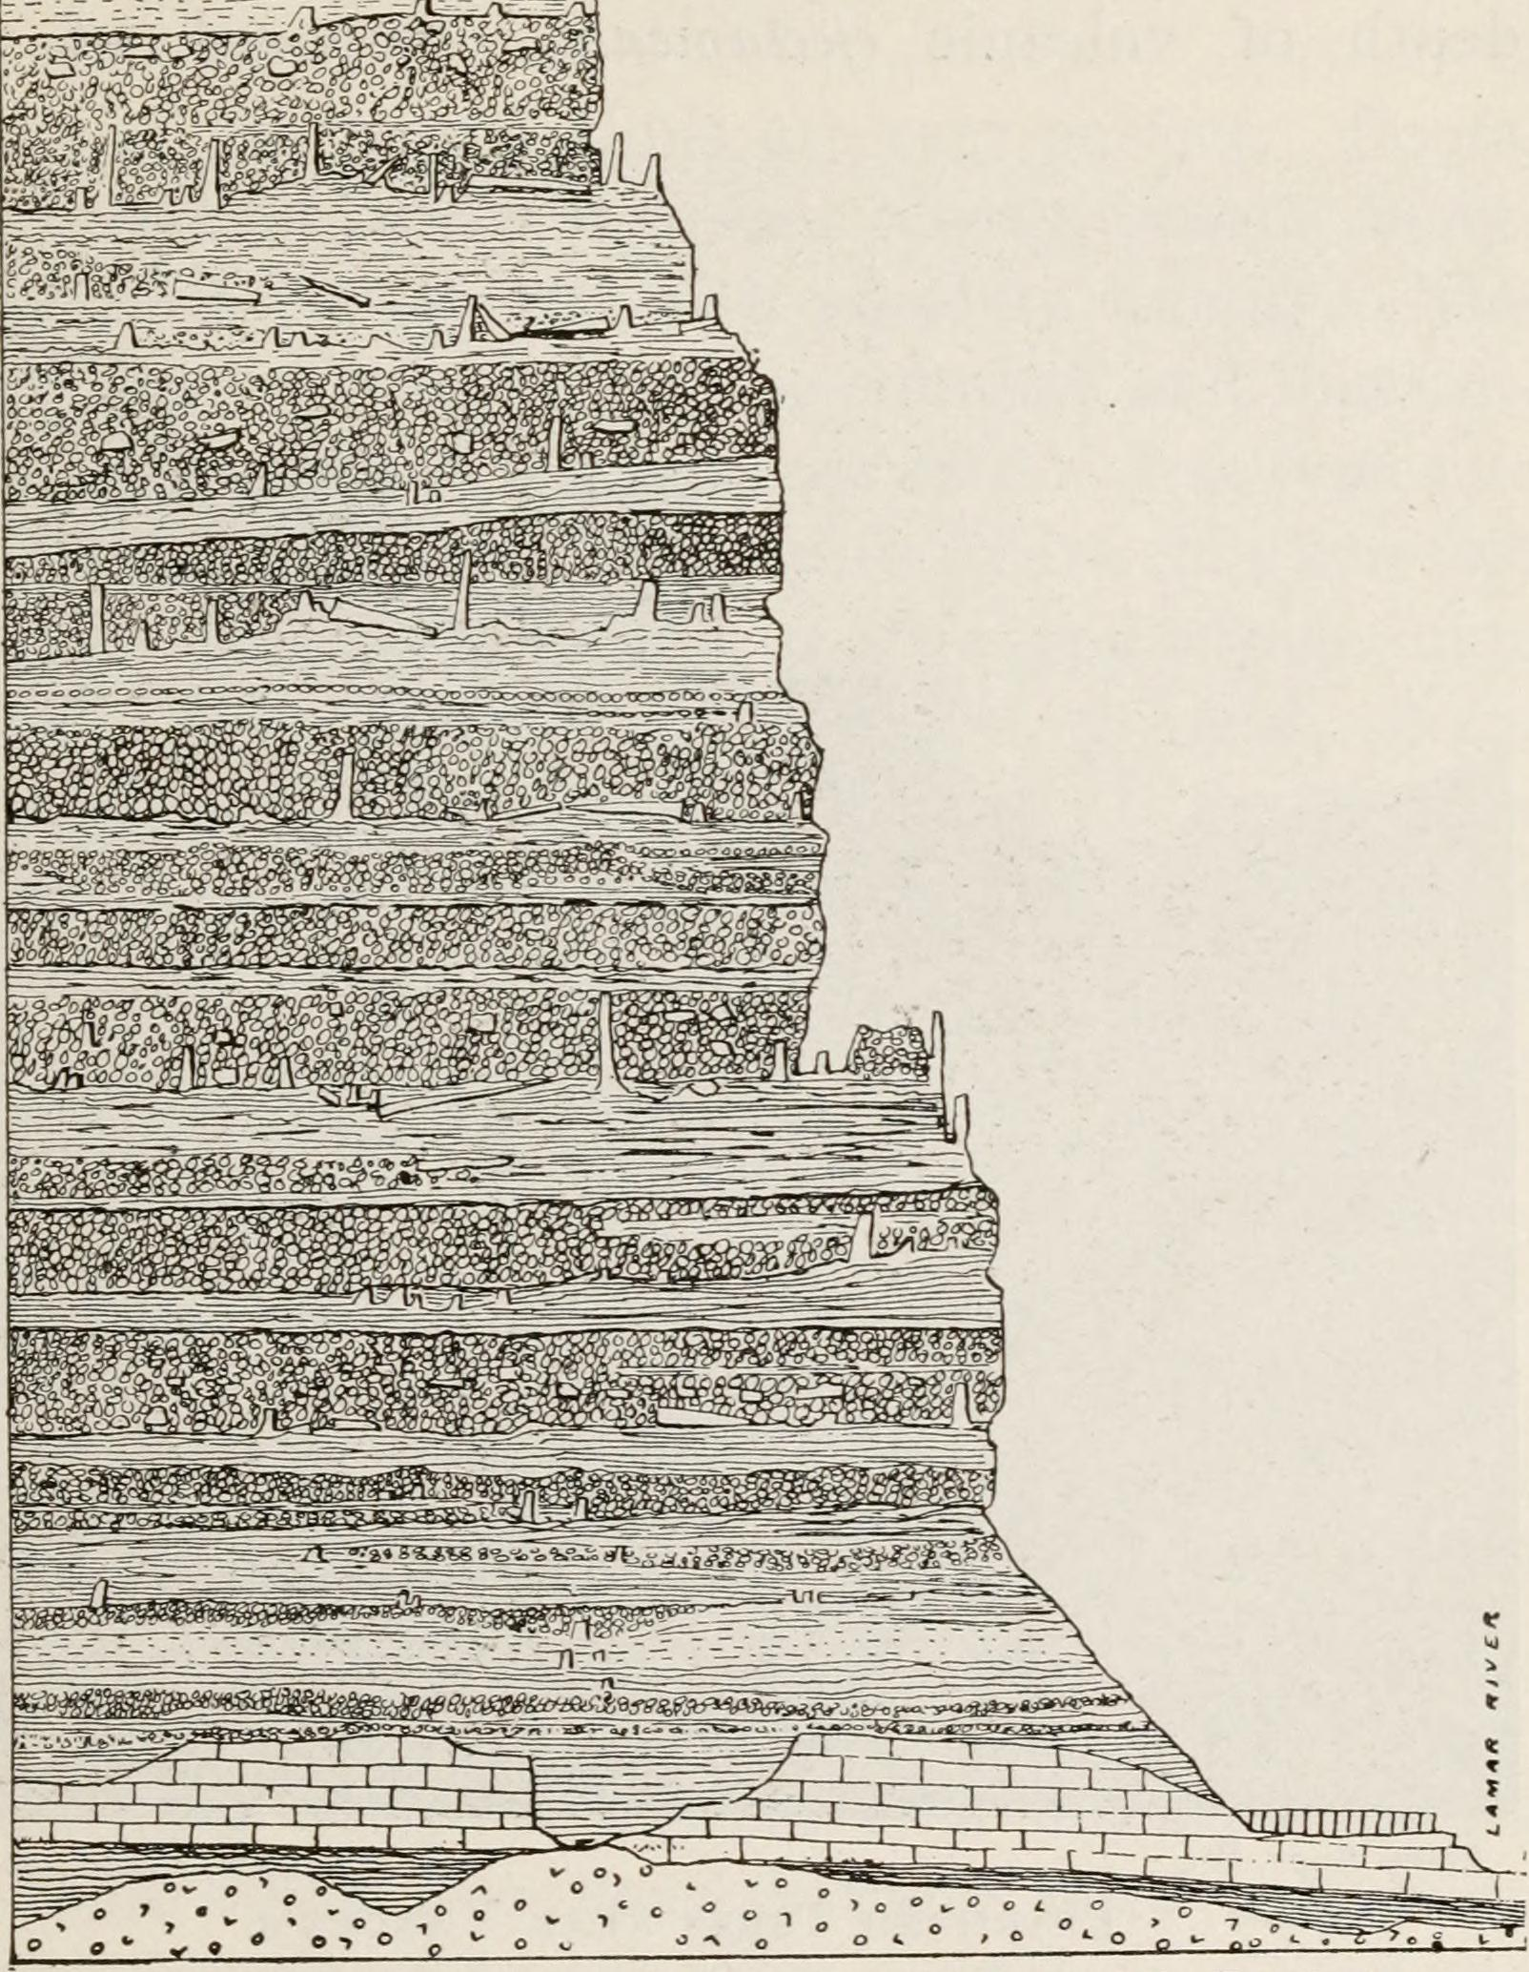

Slide 5
The story of Yellowstone “Fossil Forests”
The story of Yellowstone “Fossil Forests”
After decades of research, and special help from God, new interpretations appeared to contradict the earlier assertions about the trees.
The new interpretations favored a catastrophic interpretation for the “Fossil Forests.”
We will hear this story in a later talk.
Those who left their faith because of the earlier interpretations have not chosen to return to their former faith after the recent work, insofar as we know.
This is a warning for us.

Slide 6
The story of “Junk DNA” and “Pseudogenes”
DNA was known half a century ago to be the source of information for making proteins, the active component of cellular functions.
We knew DNA → RNA → Protein, and this became the unassailable TRUTH of molecular biology.
In the early days of our understanding of DNA, it was assumed that all of the DNA was involved in making proteins.
As scientists began to unravel the structure of DNA, it became apparent that a great deal of the DNA was not involved in making proteins.
By the 1970’s, It was assumed that the rest of the DNA was not needed, and was remnants of evolutionary process, thus “Junk DNA”

Slide 7
The story of “Junk DNA” and “Pseudogenes”
The story of “Junk DNA” and “Pseudogenes”
By the year 2000, when the Human Genome Project has completed the first phase of its work, we came to realize that only a small part of the DNA was coding for proteins, about 1.5%. What was the rest of the DNA doing? It seemed obvious that it could not be doing nothing, a conclusion that creationists had long since reached based on our understanding that the cell was the result of an intelligent design.
The US Government launched a new project called the Encode Project to find out.
Their conclusions after a decade of research were astonishing to some, but anticipated by others.

Slide 8
The story of “Junk DNA” and “Pseudogenes”
The story of “Junk DNA” and “Pseudogenes”
JUNK DNA:
HAT ADVENTIST UNIVERSITY OF CENTRAL AFRICA
HATahdfoaehajADVENTISTjUNIVERSITYjOFiCENTRALiAFRICAhdaiehdk
Pseudogenes:
UNIVERSITYaddfheadofiehaUNIVERSITYahdfheoaafhekldo
UNIVRRSITYaddfheadofiehaUNIVERSITYahdfheoaafhekldo

Slide 9
“Junk DNA” and “Pseudogenes”
The story of “Junk DNA” and “Pseudogenes”
The encyclopedia of DNA elements (ENCODE) is a public research project launched by the US national human genome research institute (NHGRI) in September 2003, (including over 400 scientists). One main accomplishment described by the ENCODE consortium has been that 80% of the human genome is now "associated with at least one biochemical function.” (2012) Much of this functional non-coding DNA is involved in the regulation of the expression of coding genes. furthermore the expression of each coding gene is controlled by multiple regulatory sites located both near and distant from the gene. these results demonstrate that gene regulation is far more complex than was previously believed.

Slide 10
The story of Pseudogenes
The story of “Junk DNA” and “Pseudogenes”
Scientists discovered that some regions of DNA looked like genes, but did not make any protein products. In some cases they looked like genes that had experienced harmful mutations.
Chimpanzees have some of these same pseudogenes, with the same differences from the original gene as in humans.
This led to the assertion that pseudogenes “proved” that humans and chimpanzees had a common ancestor.
An Adventist, Gary Gilbert picked up on this and shared it widely in the Adventist community. It was the evidence that persuaded many to leave the Adventist faith.

Slide 11
The story of Pseudogenes
The story of “Junk DNA” and “Pseudogenes”
People left their faith in Christ because they perceived that this evidence was persuasive and it was “scientific” and thus the Bible (God) must be wrong.
Instead, as science learned more, the evidence turned out not to support the assertion. They were wrong.
These people who left their faith over pseudogenes do not appear to have noticed. They are not returning to the church insofar as I am aware.
There is great danger in choosing to believe men, rather than God. Man will always be wrong, although we may never know the whole story.

Slide 12
There Are Issues That Challenge the concept of a Fiat Creation
Radiometric dating
Other dating methods
Fossil record
Orderly fossil record
Hominid record
Etc.

Slide 13
There Are Issues That Support the Concept of a Fiat Creation
Origin of life
Fossil record
Sudden appearances
General absence of intermediate forms
Sedimentology and Catastrophism
Evidence of extraordinary events.
General lack of evidence for time.
Molecular biology

Slide 14
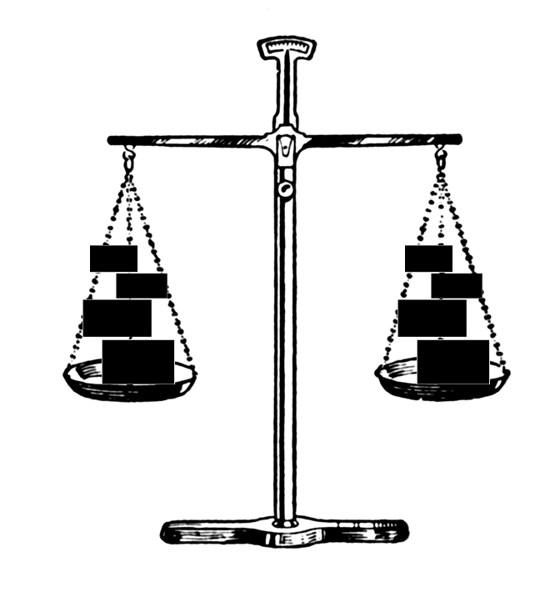
What Science Appears to Tell Us at this Period of Earth History:
Evolution
Creation

Slide 15
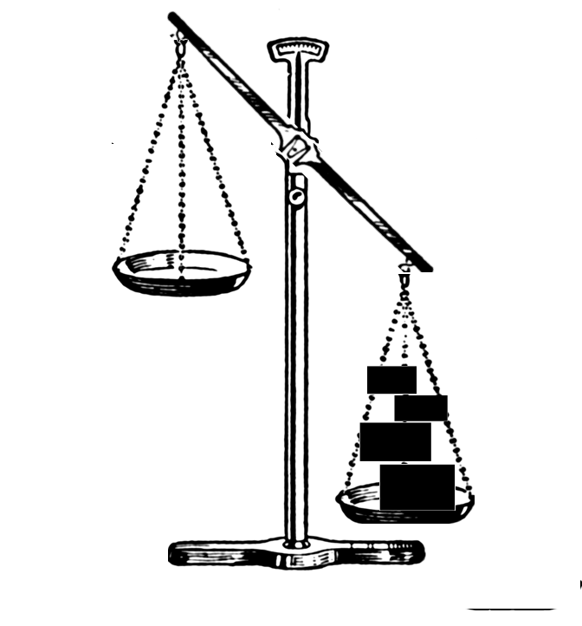
What we would like to see: (?)
Evolution
Creation

Slide 16
…or this:
Evolution
Creation
Evolution
Creation

Slide 17
What we See Right Now:
Evolution
Creation

Slide 18
Conclusion:
A = B
A = B
Therefore:
For those who know the science, the decision about origins is always going to be based upon something other than science.

Slide 19
Summary
Giving up belief based on science has historically been an ill-advised path.
Presently there are a lot of data that are interpreted to support evolution and long ages for life on earth
Presently there are also a lot of data that support design and the interaction of a supernatural being with the history and science of humanity.
What you decide to believe will always be a belief choice.

