Slide 1
The Biblical Foundation for Adventist Education
Adventist
Education
By E. Edward Zinke
Illustrations by David Zinke
and Carol Raney
Motivation by Doug Zinke
and by Seven Grandchildren
Notes:
Add your name
*

Slide 2
History of Method in Biblical Studies

Slide 3
Historical-Critical Biblical Interpretation
Natural continuity from nature to world of religion
Move within and presuppose the natural world order
Historical-critical method
Literary criticism
Form criticism
Reader Response
Redaction criticism
Tradition criticism
Redaction criticism
Etcetera
Notes:
Contemporary method in biblical studies also grows out of the concept that there is natural continuity from the realm of nature to the world of religion. The historical-critical method and the related methods of literary criticism, form criticism, redaction criticism, and tradition criticism, etc. all move within and presuppose the natural world order.
*

Slide 4
Historical-Critical Biblical Interpretation
Accepts the norms of contemporary historical science as a means for studying Scripture
It is a new “metaphysic” – a new way to understand the world

Slide 5
Old metaphysic
scholasticism
“What is rational is real”
New metaphysic
“Only that which can be studied within the flow of history can be accepted as real”

Slide 6
Historical-Critical Biblical Interpretation
The norms of history and science are employed to determine the nature of the Bible and to test all of its truth claims.
The method pre-supposes that the Bible is not the inspired Word of God.. Or
If the Bible is the Word of God, that will be determined by the method.

Slide 7
Contrary to the claims of the Bible, in general, the historical critical method and its attendant methods:
pre-suppose that the Bible is not the inspired Word of God.
assume that the Bible came by the will of man rather than by the will of God
As such, the Bible must be studied by the same methods as are applied to any other piece of literature.

Slide 8
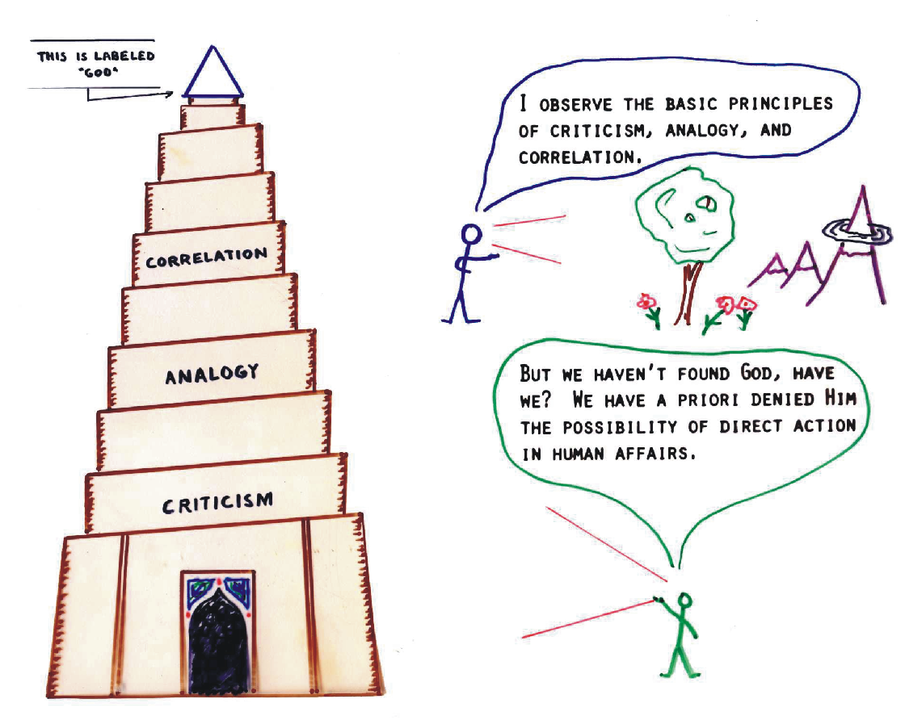
Notes:
Criticism – the human mind is the authority – everything must pass by the scrutiny of the mind to determine its validity.
Analogy – the present is the key to the past. Whatever does not take place in the present means that it did not happen in the past.
If there are no resurrections today, there were none in the past. There is no special creation today –therefor there was none 6000 years ago.
Correlation – everything is interrelated by cause and effect. A cause from outside the system is not allowed. Supernatural events are not allowed.
*

Slide 9
Notes:
*

Slide 10
Notes:
*

Slide 11
Notes:
*

Slide 12
Notes:
*

Slide 13
Notes:
*

Slide 14
White on Higher Criticism
Truth is seen to be something apart from the bible. The task of the Biblical scholar is to use the tools of historical and literary study as the basis for determining what is of value and truth.
Those who intend to hold to a method which arises out of Scripture cannot safely apply the methods of contemporary biblical criticism, for in so doing they would place Scripture itself under an external criterion.
“The warnings of the word of God regarding the perils surrounding the Christian church belong to us today. As in the days of the apostles men tried by tradition and philosophy to destroy faith in the Scriptures, so today, by the pleasing sentiments of higher criticism, evolution, spiritualism, theosophy, and pantheism, the enemy of righteousness is seeking to lead souls into forbidden paths.
Notes:
Add the box to the next slide – gives it a warning emphasis – thanks (Done)

Slide 15
To many the Bible is as a lamp without oil, because they have turned their minds into channels of speculative belief that bring misunderstanding and confusion. The work of higher criticism, in dissecting, conjecturing, reconstructing, is destroying faith in the Bible as a divine revelation. It is robbing God's word of power to control, uplift, and inspire human lives.” {AA 474.1}

Slide 16
Notes:
dissecting, conjecturing, reconstructing
*

Slide 17
Critical Thinking
Hisotry: Socrates, Platoe, Aristotle, Thomas Aquinas, Francis Bacon, Decart, Darwin, ect.
Human Judgment is foundational
Autonomy of the human learner – self guided self
Uiniversality – applies to all disciplines
Foundation for belief
Foundation for moral decision making

Slide 19
Reader Response Criticism
With a new philosophical system, there comes a new method of interpretation.
Reader response theory harmonizes with post modern thinking.
The meaning of a text is determined by the reader. There can be as many meanings as there are readers.

Slide 20
Notes:
Nice – how do we get larger lettering?
This is one of David’s graphics, and all the pieces are together in one graphic. You can make the entire graphic bigger (which would make it go beyond the square) but I cannot change any individual piece of it.
*

Slide 21
Notes:
*

Slide 22
Summary of Biblical-Critical Methods
Historical criteria are used to verify reports of divine activity
The Bible is studied like any other book
External authority is considered normative instead of the Bible
Notes:
Conservative contemporary biblical-critical studies assume a base within the natural world as the criterion for verifying reports of any divine activity. It is assumed that the Bible is to be studied as one would study any other book.
Such an approach to the study of Scripture imposes an external authority upon Scripture. The Bible is no longer the normative, authoritative Word of God recording His will and purpose for mankind. Rather it is tested and criticized to determine its truth value in the same way in which all other literature is tested.
*

Slide 23
Truth is something apart from the Bible
Tool of historical and literary study determine what in scripture is of value and contains truth

Slide 24
Comparing Methods of Interpretation
 | Philosophy | Method
Origen | Neo-Platonism | Allegorical Method
Aquinas | Aristotelianism | Aristotelian Epistemology
Reformation | Sola Scripture | Bible Own Interpreter
Historical Criticism | Enlightenment | Epistemological Autonomy
Reader Response | Post-Modernism | Meaning Individualized
Notes:
Nice job! Good suggestion – got it.

Slide 25
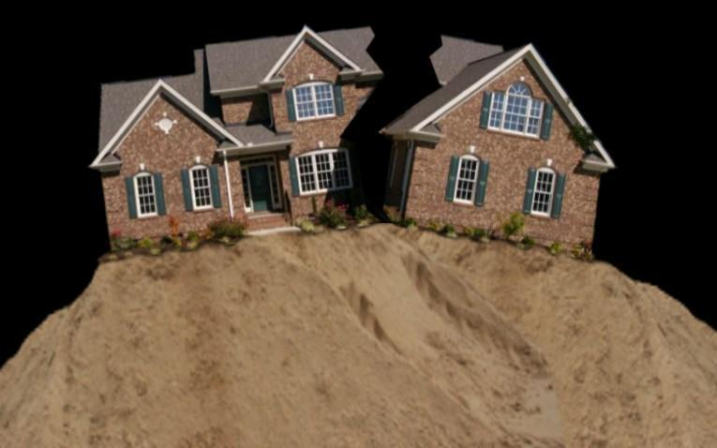
Some…
Historical Criticism
Philosophical
Theology

Slide 26
Some…
Bible Re-interpreted
On The Sand Alone

Slide 27
Those who intend to hold to a method which arises out of Scripture cannot safely apply the methods of contemporary biblical criticism, for in so doing they would place Scripture itself under external criteria.

Slide 28
Even if the conclusion of a scientific, historical, or philosophical argument were to affirm the authority of Scripture, the authority of Scripture would nonetheless rest upon the prior authority of the grounding principle.
Notes:
Such a faith based upon some aspect of the natural world is not biblical faith, for it resides within mankind rather than within the gift of God received through scripture under the power of the Holy Spirit.

Slide 29
Summary of Theological Systems
Basic continuity from the natural to the religious
It is possible to start with the natural world in the process of doing theology
Predetermined notion of the nature of God based upon contemporary world views
Notes:
At the basis of the systems which have been reviewed (with the exception of the Reformation) is the assumption that there is a basic continuity from the natural to the religious and that it is possible to start within the framework of the natural world in the process of doing theology.
These same methods by one means or another assume a predetermined notion of the nature of God and the way in which He can reveal Himself.
*

Slide 30
Results of the Era of Enlightenment
Knowledge of the natural world is not to be determined by special revelation
Knowledge of the natural world is discovered by naturalistic methods
Notes:
The nature and foundation of knowledge of the natural world is not to be determined by special revelation. It is to be discovered by some aspect of humanity, primarily by naturalistic methods.
*

Slide 31
Sola Scriptura
Takes seriously the self-claim of Scripture to be the authoritative word of God
Starts with Scripture as the foundation for theology
Notes:
This method, which takes seriously the self-claim of Scripture to be the authoritative Word of God, starts with Scripture as the basis for approaching theology. To start at any other point would be to compromise the authority of scripture by placing authority in some other entity.
*

Slide 32
What does Scripture have to say about its own nature and the principles by which it is to be interpreted?
“All Scripture is given by inspiration of God, and is profitable . . .2 Tim 2:16.
Scripture did not come by the will of man, but by holy men of God who spoke as they were moved by the Holy Spirit. 2 Pet 1:21
Notes:
A method which sincerely intends to be Biblical must start by asking Scripture what it has to say about its own nature and the principles by which it is to be interpreted.
See presentations by Dr. JoAnn Davidson
See presentations by Dr. Richard Davidson
*

Slide 33
Nature of Scripture
Principles for Interpretation
Biblical World View
Notes:
The Bible speaks about its own origin, and gives principles for its interpretation. (click) When the interpreter works within these parameters, rather than within contemporary world views, scripture can deliver its message to us rather than us delivering our message to it. (click) Thus the Bible is its own interpreter
Having come to an understanding of the nature of scripture from Scripture itself, (click) the inquirer may then return to Scripture regarding such other topics relevant to method as the nature of God, man, knowledge, salvation, faith and reality itself.
*

