Slide 1
State of Seventh-day Adventist Education Report
Lisa Beardsley-Hardy, PhD, MPH
Director of Education
General Conference of Seventh-day Adventists

Slide 2
Why Should the Church Offer
Adventist Education?
To redeem and restore the image of God in students and to prepare them for service in this life and the next.

Slide 3
Church Membership with Some
Adventist Education
None = 52.58%

Slide 4
Church Membership with No
Adventist Education (By Division)

Slide 5
Years of Adventist Education for
the Church’s Pastors

Slide 6
Priorities
2015-2020
Student Access
Mission-Focused Teachers
Leadership
Adventist Identity & Mission

Slide 7
Adventist Mission & Identity
Function within a biblical worldview and pursue a meaningful integration of faith and learning in all disciplines
Give the Bible and the Spirit of Prophecy their foundational role in the operation of the school
Educate the whole-person within the framework of a balanced, redemptive education that develops the ability “to think and to do” and restores in students the image of their Creator (Education, p. 17)

Slide 8
Adventist Mission & Identity
Through the AAA and IBE/IBMTE review processes:
Promote and guard Adventist essentials in all levels of education, particularly in graduate and professional programs
Adhere to Adventist philosophy of education in distance learning, intensives for non-residential cohorts, and urban campuses
Foster academic excellence, focusing on continued improvement with measurable goals of quality culture
Develop and implement spiritual master plans appropriate for the level and type of students (see KPIs such as Bible study)
Use textbooks in harmony with Adventist philosophy of education

Slide 9
Student Access
Partner with other GC Departments (Chaplaincy, Children’s Ministries, Youth, Family Ministries) to increase, through the divisions, access of all SDA students to Adventist education. To accomplish this we shall promote:
Removing barriers so as to increase percentage of SDA enrollment in Adventist schools.
Sustainable models of affordable education;
Monitor the preparation of future teachers and recruit teachers and other personnel (in line with our third goal);
Expand membership in the Adventist Professionals’ Network (http://apn.adventist.org)

Slide 10
Division/ Attached Union | Number of Schools |  |  |  |  | Number of Teachers |  |  |  |  | Number of Students
 | Prim. | Sec. | W.Tr. | Tert. | Totals | Prim. | Sec. | W.Tr. | Tert. | Totals | Prim. | Sec. | W.Tr. | Tert. | Totals
ECD | 1,491 | 725 | 12 | 7 | 2,235 | 13,275 | 8,534 | 128 | 680 | 22,617 | 465,472 | 145,152 | 2,402 | 13,291 | 626,317
EUD | 36 | 17 | 2 | 8 | 63 | 332 | 267 | 30 | 149 | 778 | 2,747 | 2,243 | 170 | 781 | 5,941
ESD | 18 | 12 | 1 | 2 | 33 | 113 | 138 | 2 | 49 | 302 | 906 | 554 | 20 | 806 | 2,286
IAD | 373 | 251 | 1 | 13 | 638 | 3,906 | 3,063 | 11 | 1,290 | 8,270 | 65,173 | 43,261 | 186 | 15,872 | 124,492
NAD | 872 | 249 | 0 | 13 | 1,134 | 2,748 | 3,929 | 0 | 4,516 | 11,193 | 22,561 | 27,829 | 0 | 24,469 | 74,859
NSD | 22 | 19 | 0 | 5 | 46 | 256 | 682 | 0 | 310 | 1,248 | 4,776 | 8,249 | 0 | 7,796 | 22,801
SAD | 584 | 330 | 0 | 18 | 932 | 11,835 | 5,420 | 0 | 3,543 | 20,798 | 229,324 | 58,213 | 0 | 29,293 | 316,830
SPD | 314 | 71 | 3 | 4 | 392 | 2,285 | 1,020 | 24 | 184 | 3,513 | 51,727 | 16,041 | 553 | 3,785 | 72,106
SID | 303 | 168 | 4 | 7 | 482 | 2,539 | 2,730 | 92 | 199 | 5,560 | 87,510 | 54,378 | 1,191 | 7,574 | 150,653
SUD | 107 | 158 | 19 | 9 | 293 | 3,528 | 5,629 | 184 | 555 | 9,896 | 46,975 | 153,590 | 1,566 | 3,760 | 205,891
SSD | 681 | 176 | 1 | 18 | 876 | 3,080 | 1,986 | 18 | 1,108 | 6,192 | 54,482 | 27,502 | 162 | 17,861 | 100,007
TED | 32 | 27 | 4 | 5 | 68 | 332 | 218 | 20 | 190 | 760 | 2,378 | 1,144 | 140 | 1,588 | 5,250
WAD | 864 | 129 | 7 | 4 | 1,004 | 7,616 | 3,021 | 66 | 727 | 11,430 | 153,014 | 45,321 | 1,776 | 15,453 | 215,564
MENA | 8 | 4 | 0 | 1 | 13 | 120 | 74 | 0 | 28 | 222 | 1,865 | 469 | 0 | 201 | 2,535
WORLD TOTALS Dec. 31, 2015 | 5,705 | 2,336 | 54 | 114 | 8,209 | 51,965 | 36,711 | 575 | 13,528 | 102,779 | 1,188,910 | 583,946 | 8,166 | 142,530 | 1,923,552
Notes:
Table 1World Summary of Schools, Teachers, and Students, December 31, 2015

Slide 11
The Adventist World and Big Cities
As of June 30, 2013:
Global Population = 7,134 billion
Church Members = 17,994,120
Population to Members Ratio = 396.4 to 1
Global Urban Population = 1,704,240,000 (approx. estimated)
Urban Church Members = 3,111,801 (estimated)
Global Urban Population to Members Ratio = 547.7 to 1

Slide 12
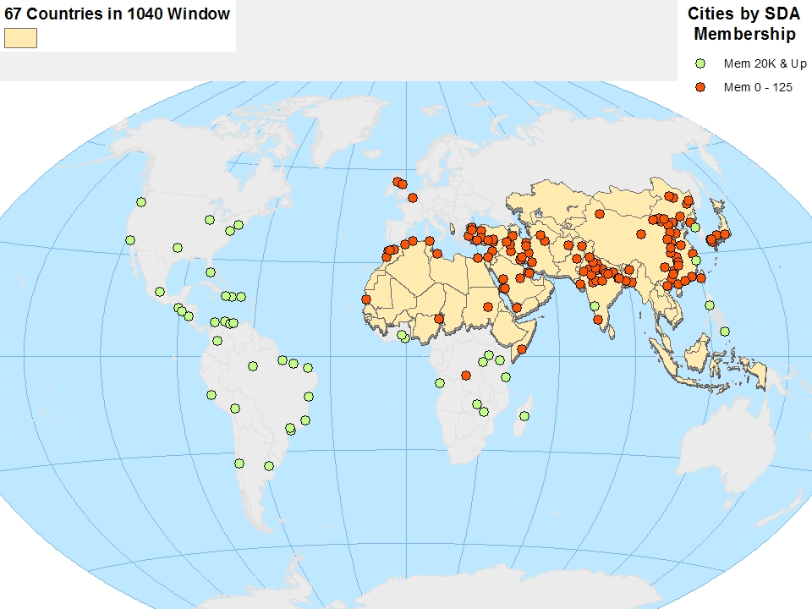
We are especially weak in big cities in the 10/40 Window and Europe

Slide 13
Proliferation of Graduate and Professional Degrees
MA/MS, MBA, MSA, MPH, MSN,
MSW, MDiv, MEd, MArch, MSCLS,
MAT, MMUS, MAPMin, MAYM, MTh,
MOT, MSD, DScPT, DPT, DSc,
DrPH, OTD, PsyD, , PharmD, DDS,
EdD, MD, MBBS, DMin, ThD, PhD and more!

Slide 14
Students Who Are Church Members
SDA Senior Youth/Young Adults* who are attending SDA Colleges and Universities
74,298
5,944,930
Senior Youth/Young Adults *
who are Church members
Statistics from December, 2012, 2013
*16-31 years old
Notes:
http://www.uis.unesco.org/Library/Documents/fs10-trends-tertiary-education-sub-saharan-africa-2010-en.pdf
End of 2013 membership was 18,143,745. Globally, in 2013, 33.62 per cent of surveyed church members were aged 16-30. As you will recall, this didn’t cover all thirteen divisions but it did include the larges and, importantly, it included NAD and TED, which have ageing populations, as well as Africa and Latin America, which are very youthful. So it is likely representative. Extrapolating this percentage, it would mean there were 6,099,927 SDAs aged 16-30. As of the end of 2013, there were 3,434,080 church members in the ACMS software. Of these, 1,095,865 were aged 16-30 - i.e., 31.91%. The fact that the percentage is almost the same means, of course, that the two differently derived datasets are mutually reinforcing and that lends confidence to the figure. If we extrapolate this percentage it would mean there were
5,789,933 SDAs aged 16-30.This indicates that 32 or 33% of church members are aged 16-30, which translates into between 5.8 and 6.1 million young people. The number 5,944,930 is an average of 5,789,933 and 6,099,927. 74,298 out of 136,711 or 54% of total enrollment in SDA tertiary enrollment is SDA.

Slide 15
Students Who Are Church Members Attending Non-SDA Institutions
SDA Senior Youth/Young Adults* who are attending SDA Colleges and Universities
74,298
1,471,384
Senior Youth/Young Adults *
who are Church members but
attending a non-SDA institution
Statistics from December, 2012, 2013
*16-31 years old
Notes:
http://www.uis.unesco.org/Library/Documents/fs10-trends-tertiary-education-sub-saharan-africa-2010-en.pdf
End of 2013 membership was 18,143,745. Globally, in 2013, 33.62 per cent of surveyed church members were aged 16-30. As you will recall, this didn’t cover all thirteen divisions but it did include the larges and, importantly, it included NAD and TED, which have ageing populations, as well as Africa and Latin America, which are very youthful. So it is likely representative. Extrapolating this percentage, it would mean there were 6,099,927 SDAs aged 16-30. As of the end of 2013, there were 3,434,080 church members in the ACMS software. Of these, 1,095,865 were aged 16-30 - i.e., 31.91%. The fact that the percentage is almost the same means, of course, that the two differently derived datasets are mutually reinforcing and that lends confidence to the figure. If we extrapolate this percentage it would mean there were
5,789,933 SDAs aged 16-30.This indicates that 32 or 33% of church members are aged 16-30, which translates into between 5.8 and 6.1 million young people. The number 5,944,930 is an average of 5,789,933 and 6,099,927. 74,298 out of 136,711 or 54% of total enrollment in SDA tertiary enrollment is SDA.

Slide 16
Apn.Adventist.org
 | To begin, please select your language

Slide 17
Seventh-day Adventist Church
World Education Statistics (12/31/16)
 | Schools | Teachers | Students
Primary | 5,915 | 54,282 | 1,200,880
Secondary | 2,435 | 39,386 | 603,251
Worker Training | 50 | 604 | 5,765
Tertiary | 114 | 14,384 | 145,024
Totals | 8,514 | 108,656 | 1,954,920

Slide 18
Mission-focused Teachers
Expand the capacity of all teachers to achieve the redemptive purposes of Adventist education and to model Adventist values and lifestyle, and to increase, where needed, the percentage of Seventh-day Adventist teachers who work in the system.
Encourage induction and development of all teachers in the area of faith and learning
Increase access to the Journal of adventist education
Endorse religion and theology teachers and strengthen their role
Offer regional conferences about faith and learning, assessment of spiritual master plans, Adventist philosophy of education, etc.
Promote education as a calling, credentialing and commissioning
Add to the Handbook series for teachers

Slide 19
Percentage of Seventh-day Adventist Teachers in SDA Schools

Slide 20
Percentage of Seventh-day Adventist Students in SDA Schools

Slide 21
Leadership
Strengthen leadership and administration, and demonstrate accountability and effective governance through robust institutional decision-making processes and structures, supported by journal articles, handbooks, and board training workshops.
Make educational leaders aware of Church-produced resource materials in four main languages.

Slide 22
Leadership (cont.)
LEAD Conferences
Graduate Training for church leadership, especially at Andrews, AIIAS and AUA
Strengthen ministerial and theological education through the IBMTE Handbook
Board training
Regional “LEAD” conferences in 2017-18 but more needs to be done to develop leadership in particular for Pre/K-12 level.

Slide 23
Acknowledgements
Rick McEdwards, president, Middle East North Africa Union, Jerry Chase, Mdiv, Geographic information Specialist, General Conference of Seventh-day Adventists and David Trim, Ph.D., F.R.Hist.S., Director of Archives, Statistics, and Research, General Conference of Seventh-day Adventists.
All data reported in the Annual Statistical Reports of the Seventh-day Adventist Church, except for estimates of the number of Seventh-day Adventists enrolled in tertiary education outside of the Seventh-day Adventist system.

Slide 24
Questions and Discussion
What are sustainable models of affordable education?
No margin, no mission. How can mission be balanced with the need for a margin?

Slide 25
Group Work Super Secretaries
Pre/K-8: Rosalie McFarlane: rosaliemcfarlane@adventist.org.nz
Higher education: Dolf Oberholster: oberholster@aiias.edu
Secondary education: Ermelinda Tambalque: ermetambalque@hotmail.com
Editors: Sharon Rogers, sharonkrogers@gmail.com and Daryl Murdoch, DarylMurdoch@adventist.org.au

