Slide 1
Increasing Student Access in K to 12 Education A Challenge for Adventist Education in the 21st Century
David R. Williams, PhD, MPH, MDiv
Florence & Laura Norman Professor of Public Health
Professor of African & African American Studies and of Sociology
Harvard University

Slide 3
Investment of SDA Education
Castries SDA Primary School, St Lucia
St. Lucia S.D.A. Academy
B.Th., hons, Caribbean Union College (now, University of the Southern Caribbean, Trinidad
M.Div., cum laude, Andrews University
M.P.H., Health Education, Loma Linda University

Slide 4
Returns on Investment (SDA Education)
Accepted for PhD study in top 3 dept (University of Michigan)
1986 - 1992, Assist. to Assoc. Professor, Yale University
1992 - 2006, Assoc. to Collegiate Professor, University of Michigan
2006 – present, Norman Professor, Harvard University
Author of more than 400 scientific papers
Ranked among 10 Most Cited Social Scientists in world
Ranked as Most Cited Black Scholar in Social Sciences
Ranked by Thompson-Reuters as one of the World’s Most Influential Scientific Minds in 2014
Elected, National Academy of Medicine, 2001
Assoc. Dir, Health Ministries, Gen Conference of SDA, 2014-

Slide 6
Major Themes
Challenge of Youth Retention
Challenge of providing high quality education
Challenge of making SDA education affordable to our constituency

Slide 7
Major Themes
Challenge of Youth Retention
Challenge of providing high quality education
Challenge of making SDA education affordable to our constituency

Slide 8
Attrition
In 5-year period, 2010 - 2014, 6.2 million new members
During same period, 3.7 million members left the church
Excluding deaths, the net loss rate for the quinquennium is 60 per 100 new members
This stunningly high loss rate is due, in part, to membership audits
GT Ng, Adventist Review, 2015

Slide 9
Attrition -2
Membership audit: process of identifying and removing from membership lists people who have left the church
Considering the prior 15 years predating the recent round of thorough audits, the losses are 48 for every 100 new members
GT Ng, Adventist Review, 2015

Slide 10
Retention: Accessions vs. dropped, 2000–2012
Loss rate = 43.364 per hundred new converts

Slide 11
Losses of our Youth
Landmark NAD study that started in 1987
Over 1,500 baptized 15 and 16 year olds, representative of all SDA youth (big & small churches, small towns & big cities, public schools & SDA schools, all ethnic groups)
Interviewed every year for the next 10 years
How many of them left the church by age 25 and 26? at least 40 to 50%
We are losing one half of our youth. Not one lost coin, but half of the coins
Roger Dudley, Why Our Teenagers Leave the Church, 2000

Slide 12
Questions to Ponder?
Before we blame the youth or the Devil, let’s examine ourselves: 1. Could it be that we are responsible for this pattern? 2. Are there things that we could be doing differently that would keep many more of God’s children in the safety of His fold?
https://michaeljeshurun.files.wordpress.com/2016/02/lord-is-it-i-final.jpg

Slide 13
Our Role in the Losses of our Youth
‘It is because so many parents and teachers profess to believe the word of God while their lives deny its power, that the teaching of Scripture has no greater effect upon the youth.’
Education, page 259

Slide 14
Our Laodicean Condition
“It is one thing to treat the Bible as a book of good moral instruction, to be heeded so far as is consistent with the spirit of the times and our position in the world; it is another thing to regard it as it really is--the word of the living God, the word that is our life, the word that is to mold our actions, our words, and our thoughts. To hold God's word as anything less than this is to reject it. And this rejection by those who profess to believe it, is foremost among the causes of skepticism and infidelity in the youth.”
Education, page 260

Slide 15
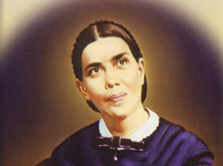
Re-affirming Our Mission
The Adventist church needs to re-affirm the central role of Christian education as part of the evangelistic mission of the church.
The need for Adventist education has never been greater than today
Ellen White said, “there should
be schools established wherever
there is a church or company of
believers. Teachers should be
employed to educate children of Sabbath-keepers”
Ellen G. White, “Special Testimony to Battle Creek Church, pg 40, 1898.

Slide 16
3 Predictors of SDA Youth being Committed
Youth who view church as relevant to their lives. 3 factors: a) Sabbath Sermons in my church are interesting; b) My church meets my spiritual needs, and c) My church meets my social needs
A grace orientation towards salvation. Someone with a grace orientation believes that salvation is based on what Jesus has done, not on what I do
Attending an SDA college. Those who attended an Adventist college more likely to be committed than those in other colleges or not in school at all. Higher education in secular universities tends to lessen religious commitment and produce religious skepticism
Roger Dudley, Why Our Teenagers Leave the Church, 2000

Slide 17
Major Themes
Challenge of Youth Retention
Challenge of providing high quality education
Challenge of making SDA education affordable to our constituency

Slide 18
What SDA Parents Are Looking For
SDA's have come of age. We want the best for our children
I have run into many parents who are intent on sending their kids to non-Adventist schools because they believe that SDA schools cannot provide the academic rigor to make their children competitive in today's world
One challenge is that many of today’s SDAs are only using secular criteria to determine what is best
But what shall it profit a man or woman if he gain the finest education but lose his own soul?

Slide 19
The Other Side
At many of our SDA schools, there is a lot of room for improvement
Too many of our schools are run by administrators who lack vision
Our constituencies have changed. Years ago, you opened a school and SDA parents sent their children.
Today, parents are looking for excellence
Don’t blame the parents! They are looking for exactly the same thing that God is looking for. God wants our schools to be the best. God wants us to be the head and not the tail. God places no premium on mediocrity.

Slide 20
But Achieving Consistent Academic Quality is a Challenge Because: 1. The low Socioeconomic Status (SES) profile of many SDAs 2. Academic Quality does not occur by chance

Slide 21
Demographic Survey Seventh-day Adventist Church in North America
Conducted for the NAD Secretariat
By Center for Creative Ministry
2007-2008

Slide 22
Annual Household Income of SDAs, 2007-08
Center for Creative Ministry, 2008

Slide 23
Low SES Profile of Many SDAs
In 2008, median household (HH) income in U.S. was $50,303
And the poverty line was $22,025 for family of four
That is, 40% of SDA HHs had income close to or below poverty level
and 70% of SDA HHs had incomes below the median level in the U.S.
Center for Creative Ministry, 2008

Slide 24
U.S. Pattern is not Unique
Historically, Adventists have recruited the majority of new adherents from lower SES groups
But with our emphasis on education, the 2nd generation has typically transitioned to the middle class
The bottom-line is that, around the world, many SDAs, especially recent converts, come from lower SES groups
Center for Creative Ministry, 2008

Slide 25
Implications of Low Income
Low income children receive less cognitive stimulation and enrichment (e.g., having parents read aloud to them or taking them to the library)
Parents of low income children spend less time in face-to-face interaction and in talking to their children
Homes of low income children have fewer educational resources such as age-appropriate toys, books and internet access
Children in these homes watch more TV and get less parental monitoring
Gary Evans, American Psychologist, 2004

Slide 26
SAT = Scholastic Aptitude Test

Slide 27
OR Student Affluence Test?

Slide 28
SAT SCORE by Family Income
Fair Test, College Board, Wall Street Journal, Oct 7th, 2014

Slide 29
Keys to Excellence

Slide 30
Money Alone is Not Enough
Simply giving more money to struggling schools and students does not have a big impact on academic performance
States that have equalized finance among schools, have reduced the gap in academic scores between high- and low- income students by 5%
Purchasing computers and other upgrades to school facilities have had no or negative effects on academic performance
Key to student performance is high-quality, individualized instruction
Cullen et al, J of Econ Perspectives, 2013

Slide 31
The Primacy of Teacher Quality
Excellence is not produced by chance
The Education Trust – a leading education advocacy organization summarizes the science
The single strongest predictor of student educational performance in the US is teacher quality
The quality of instruction provided by the teacher is the best predictor of student performance.
Even economically disadvantaged children that are taught at high levels achieve at high levels
Given the right teaching, right classes, right supports, all students can perform well
The Education Trust, “Yes we can: Telling Truths and Dispelling Myths about Race and Education in America,” 2006

Slide 32
What Determines Quality?
“The only place where success comes before (hard) work is in the dictionary”
Vidal Sassoon
http://a.abcnews.go.com/images/Entertainment/ap_vidal_sassoon_jrs_120509_wblog.jpg

Slide 33
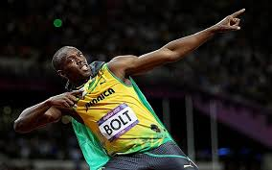
Usain Bolt: Excellence Personified
Trained every day, many
hours/day for many years
Many types of training:
weight, plyometric, circuit, flexibility, and sprint drills
Comprehensive: bouts of intensive training, then rest, massage and relaxation, then more training
Special Diet
Example: London Olympics
Won 100M race by 12 centiseconds
2nd, 3rd, 4th, 5th, 6th and 7th place finishers were all within one-third of a second of Bolt’s time
Wade, Motley Health, 2014
Notes:
--These are the percentages listed in Table 8 of U.S. Census 2006.
--“Some Other Race alone” not included
(“Number and Percentage of People in Poverty in the Past 12 Months by Race and Hispanic Origin: 2006)

Slide 34
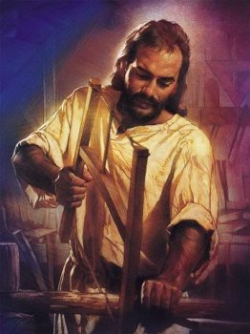
The Example of Jesus
Jesus sought to “do the best work in every line. He was not willing to be defective, even in the handling of tools. He was perfect as a workman, as He was perfect in character. By His own example He taught that it is our duty to be industrious, that our work should be performed with exactness and thoroughness, and that such labor is honorable.”
Desire of Ages, page 72

Slide 35
God’s call to Excellence
God is calling teachers to excellence. Excellence in how we represent Him. Excellence in how we teach.
Excellence in how we prepare our students to be the best that they can be in this world and the world to come.
God has called teachers to be a key part of the gospel commission. As important as those of pastors. Teachers are preparing God’s children to sit on His throne.
Imagine how teachers in your division would approach their job, if they knew that Jesus, the Majesty of heaven was going to be a student in their class. You know what, Jesus is in their classrooms. Inasmuch as you have done it unto one of the least of these, you do it unto Me.

Slide 36
Leadership Matters
High quality principals have a large impact on student academic performance
“Where there is no vision…..
Part of the success of these principals is likely due to their ability to hire high-quality teachers and fire under-performing ones.
Cullen et al, J of Econ Perspectives, 2013

Slide 37
Need for “Blessed Subtractions”
We need continuous quality improvement
We need to make a long-term and tangible commitment to improving the quality of teaching in SDA elementary and secondary schools
We need a plan to evaluate, nurture, monitor, and enhance the skills of our primary and secondary teachers
And schools of excellence have the courage and backbone to get rid of teachers who are not doing an outstanding job of teaching

Slide 38
Role of our Universities
Many elementary and secondary schools have teachers providing instruction in subjects in which they were not trained
Loma Linda University, in collaboration with six other SDA institutions started the Excellence in STEM Experiential Education (EXSEED) program
A one-week summer program brings K-12 educators from SDA schools to the Loma Linda campus to enhance their skills in the teaching of math & science
We need to build, strengthen and expand such initiatives for enhancing the quality of instruction

Slide 39
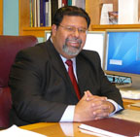
Summer Programs
What if we designed programs to strengthen the academics of SDA secondary school students, whether in SDA or public schools, and prepare them for success in higher education?
LLUs Center for Health Disparities and Molecular Medicine’s summer undergraduate Training Program (UTP) is an example
Funded by NIH - a 9-week summer internship in a research laboratory
Dr. Marino De Leon
Salto, Riggs, De Leon, Casiano, De Leon, PLoS ONE, 2014

Slide 40
Summer Program -LLU
It includes mentoring, participation in scientific seminars and lectures, educational enrichment activities
Participating students are compensated competitively on an hourly basis
High school and undergrad students in this program have showed gains in research skills and research efficacy
Program also successful in recruiting students to complete a STEM degree
A larger vision to expand programs of this type including ACT/SAT preparation classes
Salto, Riggs, De Leon, Casiano, De Leon, PLoS ONE, 2014

Slide 41
Incubators for Innovation
Quality of our academic programs are variable
We need to design and test new strategies
We need science-based (and principles-based) innovation that leads to dramatic improvements in the impact of our work
Without innovation, we will not achieve ambitious goals
We need to mobilize the creative talents of SDAs within and without our system
We need new ways of thinking, working and leading

Slide 42
Quality: A Cornerstone of Access
A Divine mandate
Indispensable to effective recruitment
Critical to winning the support of today’s SDA parents
Necessary to raising financial support for SDA education within the church
Crucial to raising financial support for SDA education from persons outside of the church

Slide 43
Major Themes
Challenge of Youth Retention
Challenge of providing high quality education
Challenge of making SDA education affordable to our constituency

Slide 44
Demographic Survey Seventh-day Adventist Church in North America
Conducted for the NAD Secretariat
By Center for Creative Ministry
2007-2008

Slide 45
Challenge for Many SDA Parents
The low economic status of many SDA HHs means that many parents who would like to send their children to SDA schools cannot afford the tuition payments and desperately need financial assistance
In recent years, SDA membership in NAD is increasing among the lower middle and middle class, but declining among households above the national median income
A large and growing share of the church’s membership will be unable to financially afford SDA education under current funding arrangements
Center for Creative Ministry, 2007-2008

Slide 46
What Can We Do?

Slide 47
New institutional commitment

Slide 48
The 5% Solution
Recently proposed by Thambi Thomas of Pacific U
Call to update the formulas used to support education
Asks church to increase its commitment to funding primary and secondary education by allocating an additional 5% of tithe income in every conference in NAD to support church school education
In the PU in 2009, this plan would have generated an additional $8 million dollars
This proposal is fully consistent with regarding Christian education as an essential evangelistic ministry of the church.
Thambi Thomas, in Peril and Promise, 2012

Slide 49
Innovation

Slide 50
Learn from the Catholics?
Effort to improve quality and lower costs in urban education in Roman Catholic schools
Urban Catholic schools have been facing declining enrolment with many schools closing in recent years
Seton Education Partners developed the Phaedrus Initiative which has been successful in increasing student enrolment, decreasing teaching staff, reducing per pupil costs by 20 to 25% and improving academic achievement.
Seton Partners, “Phaedrus Initiative”, 2014

Slide 51
Phaedrus Initiative
Key to Seton’s success is the combination of blended learning combined with best practices to increase student enrolment, achievement and motivation, as well as, to improve teacher quality and school culture
Blended-learning model: combines computer-based learning with small group, traditional classroom instruction
Many schools use the in-classroom rotation model
Core academic class periods divided into two segments: In 1st segment, teacher works with half of students in small group instruction while the other half of the class works on their computers, using guided instruction
Seton Partners, “Phaedrus Initiative”, 2014

Slide 52
Phaedrus Initiative -II
For 2nd segment, the students switch
Teachers use information from the students’ work on the computers to identify and address subject areas that need additional emphasis
Model enables schools to increase enrolment, without having to employ additional teachers but still maintain a good ratio of students to teachers
With classroom of 30 students, individual students interact with their teacher in groups of 15
The model is educationally and economically efficient
Seton Partners, “Phaedrus Initiative”, 2014

Slide 53
Free Tuition
College of the Ozarks is a Christian liberal arts college of about 1,400 students in Missouri
Focus on character building and developing a strong work ethic, it is committed to providing high quality, Christian education to all who desire it
Instead of paying tuition, all students are provided work on campus (from dairy farming to custodial services) that will cover the costs of their tuition
Working 15 hours a week comes with the school’s guarantee to cover tuition expenses that exceeds what is covered by other scholarships and grants
US News & World Report, December 2012

Slide 54
College of the Ozarks
In addition to weekly work, students also work two 40 hour weeks a year when classes are not in session
Needy students can get room and board covered by working at the College for 6 weeks per term during summer break
70% of the college’s revenue comes from gifts and earnings from its endowment
Value of the endowment was $355 million in 2013
Illustrates that an institution and a committed constituency can radically transform, in a values-driven manner, the way in which Christian education is funded and delivered.
US News & World Report, December 2012
,

Slide 55
Work Opportunities
Back to the Blueprint?
Vocational training of Ozarks is at the core of the Adventist philosophy of education
Some educational experts are also suggesting that more serious attention should be given to providing a vocational path with career and technical emphases for at least some students
Such approaches have been successful in increasing graduation rates and labor market outcomes
Cullen et al, J of Economic Perspectives, 2013

Slide 56
New Commitment to Christian Education at the level of the local church and Creating a new culture supportive of SDA education

Slide 57
The Temple Plan
It is an organized program of a local church that has made the decision to pay the full tuition or a part of the tuition to a Christian school for all of the students from that local church that are attending the SDA school
Church has eligibility criteria (e.g., must be members of the church; must financially support church)
The Church pays tuition (full or part) to the school

Slide 58
The Temple Plan: Keys to Success
Local church makes commitment to Christian education and commits a substantial part of its budget to this
Parents and church members make personal commitment to Christian education and give regularly and systematically to the Christian education fund
Church members, who are not parents and do not have children in the school, contribute to fund so that students whose parents cannot pay the full tuition can be supported

Slide 59
Our Greatest Need

Slide 60
God’s Promise
“If my people, who are called by my name, will humble themselves and pray and seek my face and turn from their wicked ways, then I will hear from heaven, and I will forgive their sin and will heal their land.”
2 Chronicles 7:14 NIV

Slide 61
Revival and Reformation
“Revival signifies a renewal of spiritual life, a quickening of the powers of mind and heart, a resurrection from spiritual death. Reformation signifies a reorganization, a change in ideas and theories, habits and practices.” TM 128

Slide 62
Some Hard Questions to Consider
Do we need to re-think our educational structures?
Do we have the vision and the systems in place to create the kind of academic leadership that our schools need?
Do we have a plan that equips our principals to enable all of our teachers to learn, grow and excel?
Are conference nominating committees and school boards equipped to select the leadership that our schools need?
Are we intentional and informed in selecting academic leaders at the local level?

Slide 63
Could This be True of Your Institution?
“Whenever we hire a good administrator, it is by accident”
Member of the Board of SDA School
https://cdn2.hubspot.net/hubfs/1757102/Blog_images/blog_image.jpg

Slide 64
The 7 Last Words of the Church
“We never tried it that way before”
https://images-na.ssl-images-amazon.com/images/I/61muTPwaR0L._SL500_SY344_BO1,204,203,200_.jpg

Slide 65
An Open Mind is a Key to Unity
“Those who think that they will never have to give up a cherished view, never have occasion to change an opinion, will be disappointed. As long as we hold to our own ideas and opinions with determined persistency, we cannot have the unity for which Christ prayed. God and Heaven alone are infallible. We have many lessons to learn, and many, many, to unlearn.”TM 3

Slide 66
Arise and Go Over this Jordan
“Have I not commanded you? Be strong and of good courage; do not be afraid, nor be dismayed, for the Lord your God is with you wherever you go.” Joshua 1:9, NKJV
,

Slide 67
No Shortage of Evidence
Describes “unexpectedly successful schools”
High- performing ones that serve large numbers of low-income students
Most principals work hard but but most lack the knowledge and skills needed to improve schools

Slide 68
Some Key Characteristics
Thoughtful, deliberate, efficient
They are schools that implement systems to improve instruction
Have programs of professional development
Leadership that works hard to:
-- build trusting relationships
-- creates a sense of urgency and purpose
Believe that students are capable of excellence and seeks to ensure the opportunity
Create a culture that celebrates academic excellence and academic improvement

Slide 69
My Story: His Leading in the Past
No opportunity for SDAs to go to high school
Visionary leadership to identify challenge and courage to respond
Faith that nothing was too hard for the Lord
A strategy that included ALL
Stepping out in Faith
Faith that God would overcome obstacles
Commitment that involved sacrificial giving
“We have nothing to fear for the future except as we shall forget the way the Lord has led us, and His teaching in our past history.” LS 196

Slide 70
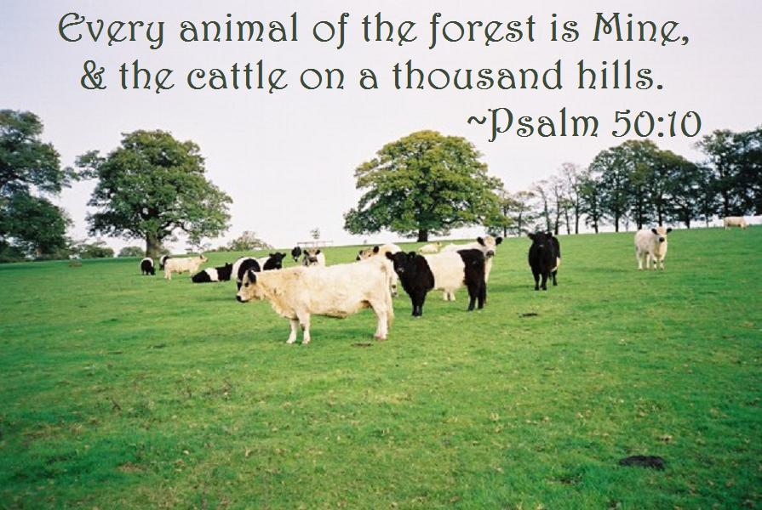
Our Big Problem
The real problem we face is not money …. It is a lack of
-- vision,
-- faith,
-- and, obedience
https://s-media-cache-ak0.pinimg.com/originals/13/eb/da/13ebdac05af7789271e6f7a7167a76da.jpg

Slide 71
Our Opportunity to Lead
SDA schools have an enormous opportunity to become centers of excellence that specialize in ensuring academic success for students from low income backgrounds
Adventist institutions can become national and global models for other schools in how to effectively nurture, support, and ensure academic excellence for students who come to us with less than optimal academic preparation

Slide 72
Guarantee: Our God is Able
“Worry is blind, and cannot discern the future; but Jesus sees the end from the beginning. In every difficulty He has His way prepared to bring relief. Our heavenly Father has a thousand ways to provide for us, of which we know nothing. Those who accept the one principle of making the service and honor of God supreme will find perplexities vanish, and a plain path before their feet.” DA 330

